Slide 1
Mass Movements, Wind, and Glaciers
Section 1: Mass Movements
Section 2: Wind
Section 3: Glaciers

Slide 2
Section 1: Mass movements alter Earth’s surface over time due to gravity moving sediment and rocks downslope.
Section 2: Wind modifies landscapes in all areas of the world by transporting sediment.
Section 3: Glaciers modify landscapes by eroding and depositing rocks.

Slide 3
Section 1 – Mass Movements
Essential Questions:
What is the relationship between gravity and mass movements?
What factors affect mass movements?
What are the different types of mass movements and how are they described?
How do mass movements affect people?

Slide 4
Mass Movements
Mass movement is the downslope movement of soil and weathered rock resulting from the force of gravity.
Mass movements can carry weathered debris downslope.
All mass movements occur on slopes.
Mass movements can vary in speed and type of material carried.

Slide 5
Types of Mass Movements
Creep is the steady, downhill flow of loose weathered materials, especially soils.
The movement may only be a few centimeters per year and only noticeable after long periods of time.
Creep usually occurs in areas of permafrost.

Slide 6
Creep

Slide 7
Flows is the mass movement of Earth materials as if they were thick liquids.
Earthflows are slow movements of soils.
Mudflows are swift movements of mud and water.

Slide 8
Earthflow

Slide 9
Mudflow

Slide 10
Landslides are the rapid, downslope movement of Earth’s materials that occur when a thin block of soil, rock, and debris separates.
The slide stops and becomes a pile of debris at the bottom of a hill.
Slides are common after heavy rains.
Rockslide is a type of landslide when a sheet of rock moves downhill.

Slide 11
Slumps is when a mass of material in a landslide moves along a curved surface.
Slumps occur along steep slopes and occur after heavy rains.

Slide 12
Avalanches occur in mountainous areas with accumulations of thick snow.
Avalanches usually occur in early and late winter or when the sun warms the snow which refreezes at night causing slippery ice crystals.

Slide 13
Rockfalls occur on high cliffs where rock fragments are loosened by physical weathering.
Rockfalls often occur in areas with road cuts and rocky shorelines.

Slide 14
Landslide

Slide 15
Rockslide

Slide 16
Avalanche

Slide 17
Rockfalls

Slide 18
Mass movements are natural however human activities contribute to them.
Construction and oversteepening of slopes contribute to mass movements.
Risk can be reduced by diverting water, installing steel netting, and building retaining walls.

Slide 19
Steel Netting to Prevent Rockfalls

Slide 20
Section 2 – Wind
Essential Questions:
What are the conditions that contribute to the likelihood that an area will experience erosion?
What features are characteristic of wind erosion and deposition?
How do dunes form and migrate?

Slide 21
Wind Erosion and Transport
Rapidly moving air can pick up and carry sediment the same way that water does.
Winds, except hurricanes and tornadoes, cannot carry large particles.
Dry conditions and lack of vegetation contributes to wind erosion.

Slide 22
Deflation is the lowering of land surfaces from the wind’s removal of surface particles.
This was very evident during the Dust Bowl of the 1930’s when large areas of the Great Plains were affected by a drought, lack of vegetation, and winds that blew the topsoil away. The blowing dirt and dust caused the skies to darken during the day.

Slide 23
Abrasion occurs when particles such as sand rub against other surfaces.

Slide 24
Wind deposition occurs in areas where wind velocity decreases.
Dunes occur where an object, such as a rock, blocks the particles.
Dunes will continue to migrate (move) from the windward (side from where the wind is coming from) to the leeward (side opposite from where the wind is coming from).

Slide 25
Wind Erosion

Slide 26
Deflation

Slide 27
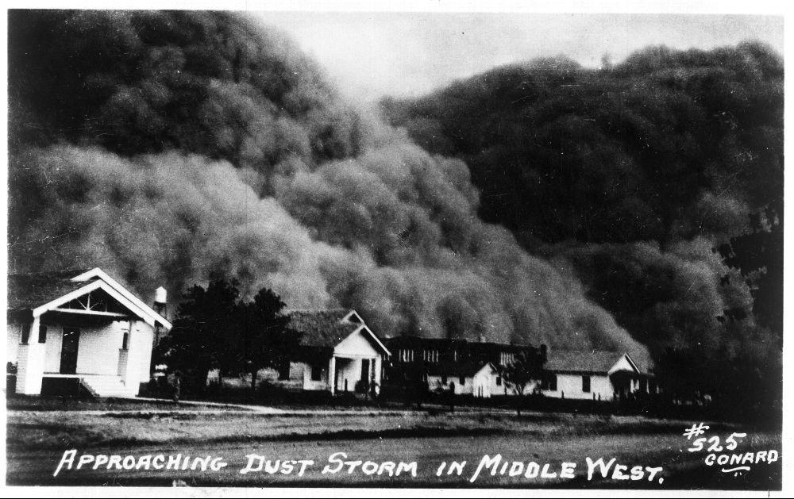
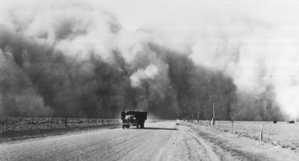
Dust Bowl

Slide 28
Wind Deposition

Slide 29
Types of Dunes
Barchan
Tranverse
Parabolic
Longitudinal

Slide 30
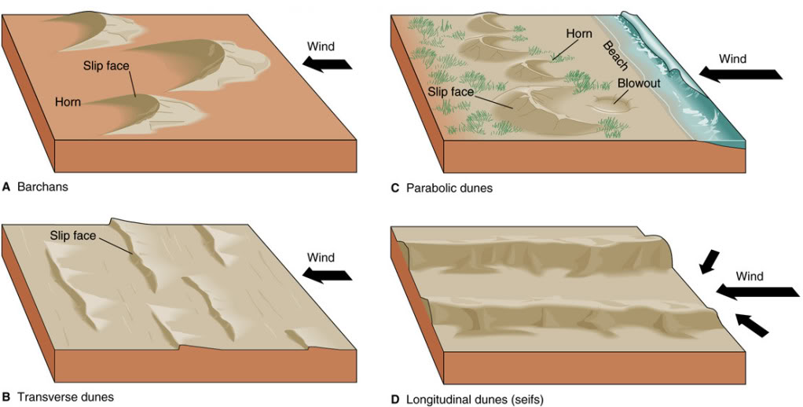
Types of Dunes

Slide 31
Section 3 - Glaciers
Essential Questions:
How do glaciers form?
What are the similarities and differences between valley glaciers and continental glaciers?
How do glaciers modify landscapes?
What features are characteristic of glacial erosion and deposition?

Slide 32
A glacier is a large mass of moving ice.
Glaciers form near Earth’s poles and in mountainous areas at high elevations.
They currently cover about 10% of Earth’s surface.
During our last ice age, glaciers covered about 30% of Earth.

Slide 33
Last Ice Age

Slide 34
Current Glaciers

Slide 35
Areas such as Greenland, Antarctica, and high elevations in the Alps have year round snow.
The continued pressure of the snow causes the snow to form into ice.
The pressure causes the ice to move in an outward direction.
There are 2 types of glaciers:
Valley
Continental

Slide 36
Valley glaciers form in the valley of mountains and move down the mountain valley.
The movement causes the formation of a U-shaped valley.
Continental glaciers cover broad, continent sized areas and currently cover Greenland and Antarctica.
Accumulation of snow causes the glacier to move in an outward direction.

Slide 37
Valley Glacier

Slide 38
Continental Glacier

Slide 39
Glacial Erosion
Glacial erosion is the most powerful of all types of erosion.
Glaciers will pluck large pieces of bedrock as they move.
The large pieces act like sand on sandpaper placing scratches on exposed bedrock and abrading the rocks below.
You can tell the direction of the glacier by the direction of the grooves.

Slide 40
Glaciers will gouge out large bowl-shaped depressions called cirques.
Two cirques on opposite sides of a valley form a steep ridge called an arête.
When 3 or more cirques are on a mountaintop they form a horn.
The most famous is the Matterhorn.
Valley glaciers leave hanging valleys.
Hanging valleys often have high waterfalls.

Slide 41
Glacial Landscape

Slide 42
Glacial Deposition
Glacial till is the unsorted rock, gravel, sand, and clay that glaciers carry.
Glaciers deposit this till when they stop and melt.
This deposit is called a moraine.
Terminal moraines are found at the end of glaciers.
Lateral moraines are parallel to the moraine.

Slide 43
Moraines of Long Island

Slide 44
The area at the leading edge of the glacier where the meltwater flows and deposits outwash is the outwash plain.
Kettles are lakes formed when a large block of ice breaks off and is surrounded by sediment.
The glacial ice melts and forms a lake.
Lake Ronkonkoma is an example of a kettle.

Slide 45
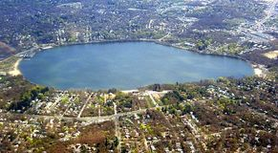
Lake Ronkonkoma

