Slide 1
Sedimentary and Metamorphic Rocks
Section 1: Formation of Sedimentary Rocks
Section 2: Types of Sedimentary Rocks
Section 3: Metamorphic Rocks

Slide 2
Section 1: Sediments produced by weathering and erosion form sedimentary rocks through the process of lithification.
Section 2: Sedimentary rocks are classified by their mode of formation.
Section 3: Metamorphic rocks form when preexisting rocks are exposed to increases in temperature and pressure and to hydrothermal solutions.

Slide 3
Section 1 – Formation of Sedimentary Rocks
Essential Questions:
How are sedimentary rocks formed?
What is the process of lithification?
What are the main features of sedimentary rocks?

Slide 4
Weathering and Erosion
Wherever rock is exposed at Earth’s surface, it is continuously broken down by weathering.
Physical and chemical processes break rocks into smaller pieces.
Sediments are small pieces of rock that are moved and deposited by water, wind, glaciers, and gravity.
When sediments are cemented together they form sedimentary rocks.

Slide 7
Weathering produces rock and mineral fragments known as sediments.
These sediments range in size from huge boulders to microscopic particles.
Chemical weathering occurs when the minerals in a rock are dissolved or otherwise chemically changed.

Slide 9
Physical weathering occurs when pieces of rocks are broken off the rock into smaller grains.
During physical weathering, fragments are only smaller but remain unchanged.
Rock fragments break off along fractures or grain boundaries.

Slide 11
Erosion
The removal and transport of sediment is called erosion.
The four main agents of erosion are:
Wind
Moving water
Gravity
Glaciers

Slide 12
Glaciers are large masses of ice that move across land.
Streams carry eroded silt and clay.
Wind will carry particles.
Particles that break off will fall down due to gravity.
Particles are often carried to new locations and deposited at the new location.

Slide 13
Erosion by Wind

Slide 14
Erosion by Water

Slide 15
Erosion by Gravity

Slide 16
Erosion by Glaciers

Slide 17
Deposition occurs when transported sediments are deposited on the ground or sink to the bottom of a body of water when the wind stops blowing or the water stops moving.
Fast-moving water can transport particles farther. As the water slows down the largest particles settle out first.

Slide 18
Transported Particle Size

Slide 19
Glaciers will carry sediments of all sizes the same distance.
When the glacier stops the sediments the sediments will be deposited wherever the glacier stops.
In a landslide all the sediments will be carried and deposited at the end.

Slide 20
Glacial Formation of Long Island
https://www.youtube.com/watch?v=eeeIgDs4SdY

Slide 21
Most sediments are deposited in low areas.
As more sediments are deposited on top the sediments at the bottom are subjected to more pressure.
The increased pressure, lithification, the physical and chemical processes that transforms sediments into sedimentary rocks.

Slide 22
Lithification

Slide 23
Compaction is caused by the weight of the overlying sediments.
Cementation occurs when mineral growth glues sediment grains together into solid rock.

Slide 25
Sedimentary Features
Bedding – horizontal layering.
Graded bedding – largest particles settle out at the bottom.
Cross-bedding – inclined layers of sediments are deposited across a horizontal surface.
Ripple marks – are sediments are deposited by moving water and the sediments are deposited with ripples.

Slide 27
Cross-bedding

Slide 28
Ripple Marks

Slide 29
When a rock breaks apart the sediments are angular.
Over time wind and water will erode the sediments more and make them rounded.
Sedimentary rocks are the ONLY rocks with fossils.

Slide 30
Lesson 2 – Types of Sedimentary Rocks
Essential Questions:
How can the different types of clastic sedimentary rocks be described?
How do chemical sedimentary rocks form?
What are biochemical rocks?

Slide 31
Clastic Sedimentary Rocks
Clastic sedimentary rocks are formed from the abundance of loose deposits found around Earth.
Clastic comes from Greek and means broken.
These rocks are classified by the size of the particles they are composed of, mode of formation, and mineral content.

Slide 32
Course-grained Rocks
Course-grained rocks are composed of gravel-sized rock and mineral fragments.
Conglomerates have rounded, gravel-sized particles.
The gravel is transported by high velocity water.
During transport the gravel becomes rounded as the particles scrape and rub together.

Slide 33
Breccias are sedimentary rocks that are composed of angular fragments.
These fragments were not carried long distances.

Slide 34
Medium-grained rocks are rocks that contain sand-sized rocks and mineral fragments.
Rocks such as sandstone have porosity (a percentage of open spaces in the rocks).
Fluid can move through the spaces.

Slide 35
Fine-grained rocks
Are sedimentary rocks that consist of silt and clay-sized particles.
These rocks are often found in areas of slow moving waters like swamps that allow the small particles to settle to the bottom.
These rocks form thin layers and break easily into sheets.
The porosity is low because of the lack of holes.

Slide 37
Conglomerate

Slide 40
Siltstone

Slide 41
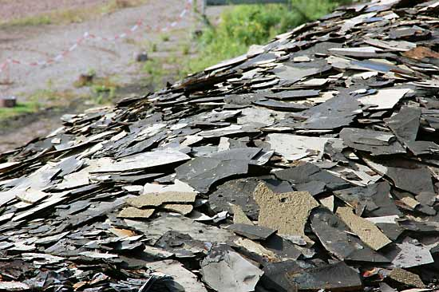

Slide 42
Chemical Sedimentary Rocks
When minerals in water reach saturation the crystals precipitate out of the water and settle to the bottom.
Layers of sedimentary rocks called evaporites form because the water evaporates and leaves the dissolved minerals behind.

Slide 43
Biochemical Sedimentary Rocks
These are formed from the remains of once-living organisms.
The most abundant of this rock is limestone.
Ancient organisms that lived in water had shells.
When the organism died, their shells settled to the bottom of the ocean.
The shells are made of calcium-carbonate.

Slide 44
Calcium carbonate precipitates out of the water and forms deposits of limestone.
Limestone contains abundant fossils.
These rocks are still being oceans as skeletal and shells continue to accumulate.

Slide 46
Rock Salt

Slide 47
Rock Gypsum

Slide 48
Dolostone

Slide 49
Limestone

Slide 50
Coal

Slide 51
Section 3 – Metamorphic Rocks
Essential Questions:
What are the different types and causes of metamorphism?
How are metamorphic features described?
How do mineral and compositional changes occur during metamorphism?
How are rocks classified using the rock cycle?

Slide 52
Metamorphic Rocks
Rocks that change due to temperature and pressure are metamorphosed.
This means they have changed.
The temperature is not hot enough to melt the rock and turn it into magma (igneous rock)
The high temperature makes the rock soft and the high pressure “molds” the rock.

Slide 53
Large scale metamorphism is seen during mountain building when large regions of the crust are heated and pushed to the surface.
This is called regional metamorphism.
Metamorphism that changes a rock is called contact metamorphism.
Minerals in the rock can change and form new minerals.

Slide 54
Metamorphic Textures
Foliated rocks have layers or bands of minerals that form during metamorphism.
Foliated rock bands are perpendicular to the pressure.
They look like layers but do not extend through the rock like in sedimentary rocks.
Gneiss is a metamorphic rock formed from granite.

Slide 55
Nonfoliated Rocks
These rocks are formed when the rock with crystals is heated and subjected to intense pressure, flattening the crystals.
Marble is formed by the metamorphism of limestone or dolomite.
The layers are compacted giving a smooth texture.

Slide 57
Regional Metamorphism
When temperature and pressure affect large regions of Earth’s crust.
The temperature and pressure forms folds and deformation as though layers of clay were squeezed together.

Slide 58
Contact Metamorphism
This occurs when rocks come in contact with an igneous intrusion.
This forms metamorphosis close to the intrusion.

Slide 59
Hydrothermal metamorphism
When very hot water reacts with rock and alters its chemical and mineral composition.
This often occurs near volcanoes and causes valuable ore deposits of gold, copper, zinc, tungsten, and lead

Slide 60
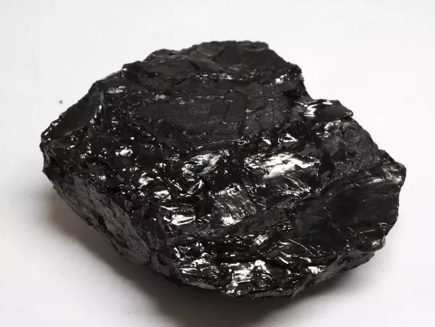
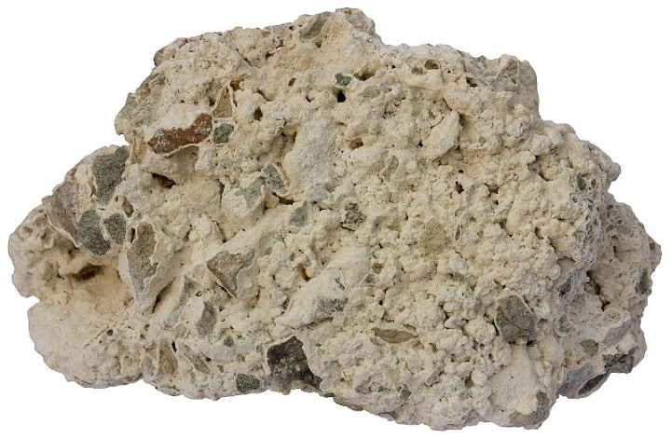
Slate

Slide 61
Phyllite

Slide 62
Schist

Slide 63
Gneiss

Slide 64
Anthracite Coal

Slide 65
Hornfels

Slide 66
Quartzite

Slide 67
Marble

Slide 68
Metaconglomerate

Slide 69
Economic Importance of Metamorphic Rocks and Minerals
Metallic mineral resources
Metallic deposits are precipitated from hydrothermal solutions.
Nonmetallic mineral resources
Metamorphism produces the mineral talc and asbestos

Slide 70
The Rock Cycle
The three types of rocks are grouped together.
The manner in which a rock is formed and changed is illustrated
The continuous changing and remaking of rocks
The arrows represent the different processes that change the rock

