Slide 1
Igneous Rocks
Section 1: What are igneous rocks?
Section 2: Classification of Igneous Rocks

Slide 2
Section 1: Igneous rocks are the rocks that form when molten material cools and crystallizes.
Section 2: Classification of igneous rocks is based on mineral composition and texture.

Slide 3
Section 1 – What Are Igneous Rocks?
Essential Questions:
How do igneous rocks form?
How can the composition of magma be described?
What are the factors that affect how rocks melt and crystallize?

Slide 4
Igneous Rock Formation
Magma is molten rock below the Earth’s surface.
Lava is magma that flows out onto Earth’s surface.
Igneous rocks form when lava or magma cools and crystallizes.
The upper mantle and lower crust heats rocks from 800°C to 1200°C and they melt.

Slide 5
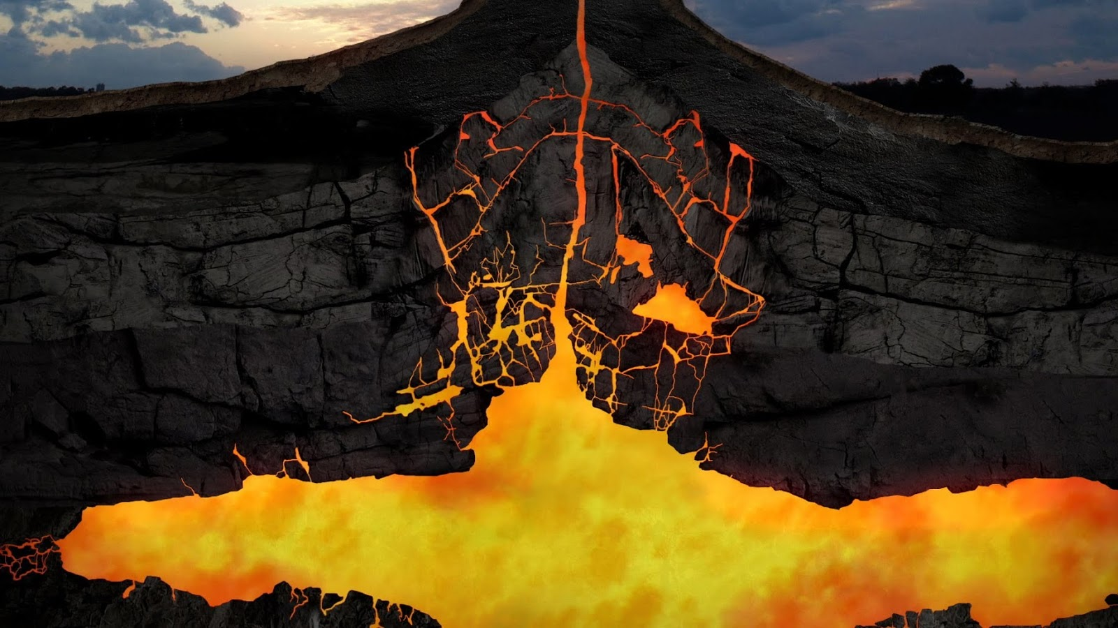
Magma

Slide 6
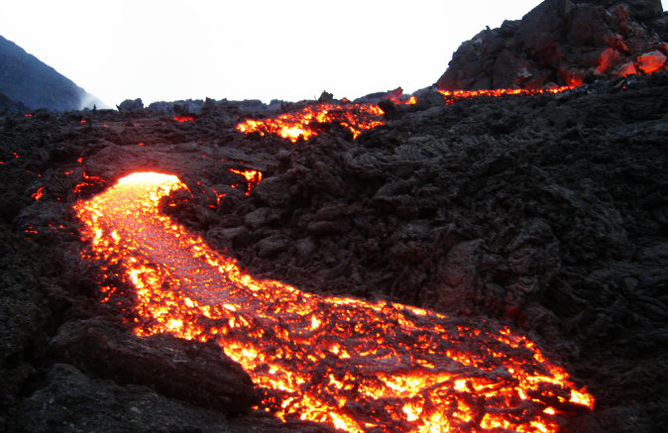
Lava

Slide 7
Igneous rocks form depending on the composition of the melting rock.
Magma is a slushy mix of molten rock, dissolved gases, and mineral crystals.
The common elements in magma are oxygen (O), Silicon (Si), Aluminum (Al), Iron (Fe), Magnesium (Mg), Calcium (Ca), Potassium (K), and Sodium (Na)

Slide 8
Silicon in the magma affects melting and viscosity.
Basaltic magma is thinner because of the silica flows easily.
As the magma moves, gases are able to escape into the atmosphere and affects the chemical composition of the igneous rocks.

Slide 9
Magma Formation
Other factors affect the formation of magma
Temperature,
Pressure,
Water content,
Mineral content.

Slide 10
As you progress deeper into Earth’s crust the temperature and the pressure increases.
Because of the increased pressure a rock that would melt at 1100°C at Earth’s surface will melt at 1400°C at 100km.
This is because the pressure of the rocks above keep the molecules from breaking apart and break apart at higher temperatures.

Slide 11
Rocks will contain small amounts of water. Rocks with more water will melt at lower temperatures.
Minerals also have different melting points.
This causes igneous rocks to have different compositions.
You may have rocks with unmelted minerals surrounded by melted rocks.

Slide 12
Section 2 – Classification of Igneous Rocks
Essential Questions:
What are the different types and textures of igneous rocks?
How do the cooling rates affect the grain sizes in igneous rocks?
What are some of the uses of igneous rocks?

Slide 13
Mineral Composition
Intrusive igneous rocks are formed when magma cools and crystallizes below Earth’s surface.
Crystals of intrusive igneous rocks form slowly and are able to grow.
If magma is injected into cracks of surrounding rocks, it is called an igneous intrusion.

Slide 14
Magma that cools and crystallizes on Earth’s surface cools quickly.
The quick cooling does not allow crystals to form or only allows very small crystals to form.
Geologists use grain size, texture, and chemical composition to classify igneous rocks.

Slide 15
Composition Classification
Basaltic Rocks
Igneous rocks that are dark colored
low silica content
contain mostly plagioclase and pyroxene

Slide 16
Granitic (Felsic) Rocks
Are light colored,
Have high silica content,
Contain mostly quartz and feldspar.

Slide 17
Ultramafic Rocks
Only iron rich minerals,
Are always dark.

Slide 18
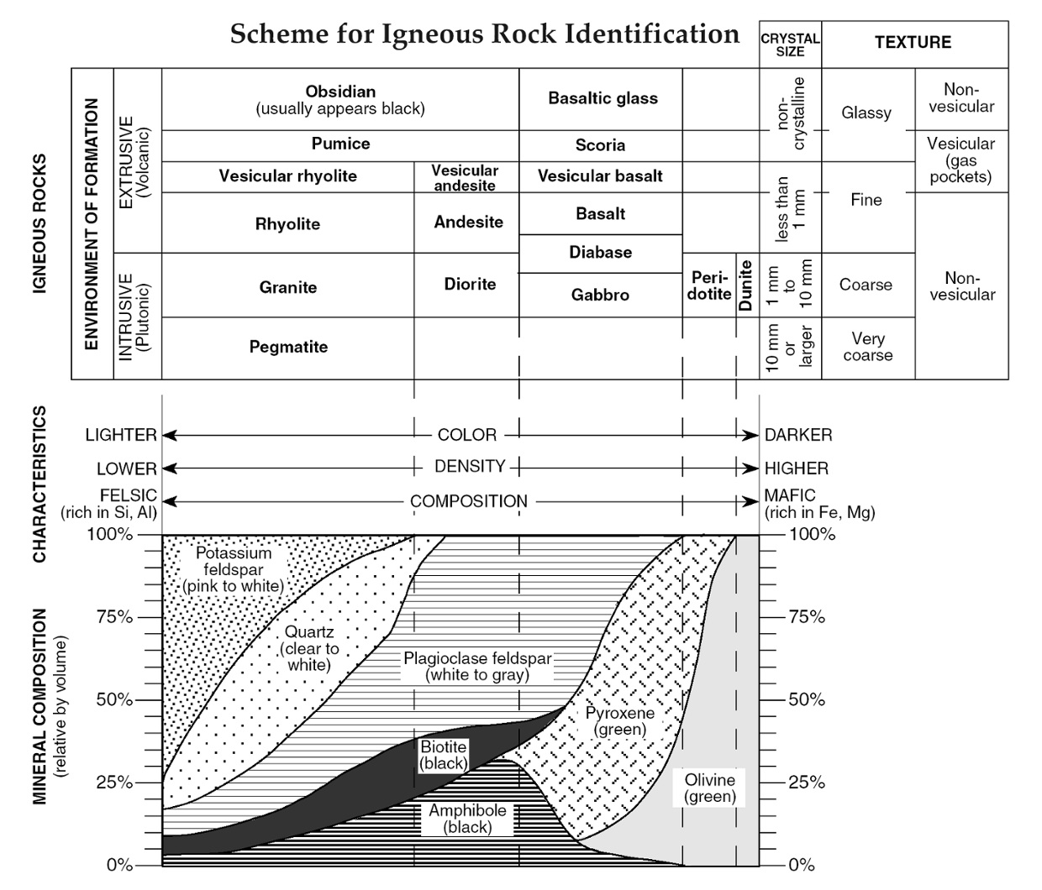

Slide 19
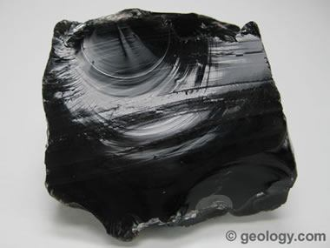
Obsidian

Slide 20
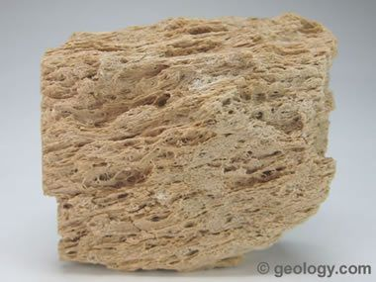
Pumice

Slide 21
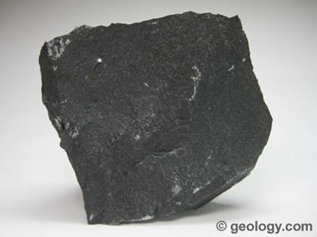
Basalt

Slide 22
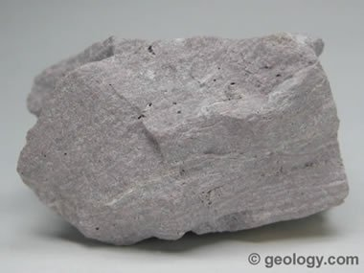
Rhyolite

Slide 23
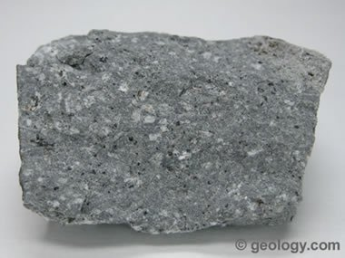
Andesite

Slide 24
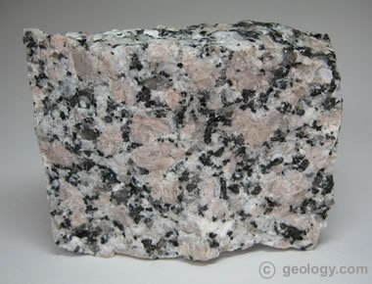
Granite

Slide 25
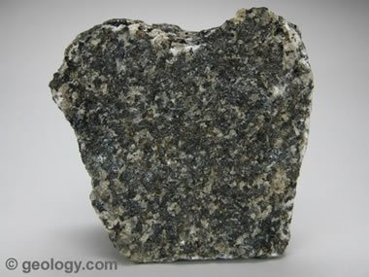
Gabbro

Slide 26
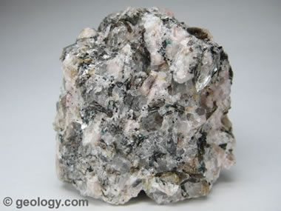
Pegmatite

Slide 27
Texture
Texture refers to the size, shape, and distribution of crystals or grains that make up an igneous rock.
The size of the grains and crystals in an igneous rocks differ.
Intrusive igneous rocks cool slowly and therefore the grain and crystal size is larger.
Obsidian has a glassy texture due to rapid cooling.

Slide 28
Porphyritic rocks are rocks with different size crystals.
They will have large, well-formed crystals surrounded by finer grained minerals.
This happens because the rock cools slowly below the ground and then is suddenly moved to the surface and the crystals cool rapidly.

Slide 29
Vesicular Rocks
Magma contains dissolved gases.
If the magma cools slowly the remnants of the gas bubbles are left behind.
The rock looks spongy.
Pumice and vesicular basalt are examples.

Slide 30
Geologists will look at paper thin slices of rocks to look at the grains and crystals.
They will also use a special microscope called a petrographic microscope to identify the minerals present.
Pegmatites are large grained igneous intrusions that can produce beautiful crystals.

Slide 31
Kimberlites are ultrabasic rocks that contains diamonds.
They may extend several kilometers into the crust but are only 100-300 meters wide.
Granite is often used in kitchen counters because of the beautiful crystals and colors. Also the counters are very durable because of how igneous rocks are formed.

Slide 32
