Slide 1
Minerals
Section 1: What is a mineral?
Section 2: Types of Minerals

Slide 2

Section 1: Minerals are naturally occurring, solid, inorganic compounds or elements.
Section 2: Minerals are classified based on their chemical properties and characteristics.

Slide 3
Section 1 – What is a Mineral?
Essential Questions:
  How are minerals defined?
  How do minerals form?
  How are minerals classified?

Slide 4
Minerals Characteristics
Earth’s crust is composed of about 3,000 minerals.
Minerals make rocks. Rocks don’t make minerals.
Mineral is a naturally occurring, inorganic solid, with a specific chemical composition and definite crystalline structure.

Slide 5
Minerals
Are naturally occurring,
  Formed from natural processes.
Are inorganic,
  Have never been alive.
Definite chemical structure,
  Atoms are arranged in regular geometric patterns.
Solids with specific chemical composition,
  Can be identified by their chemical formula

Slide 6
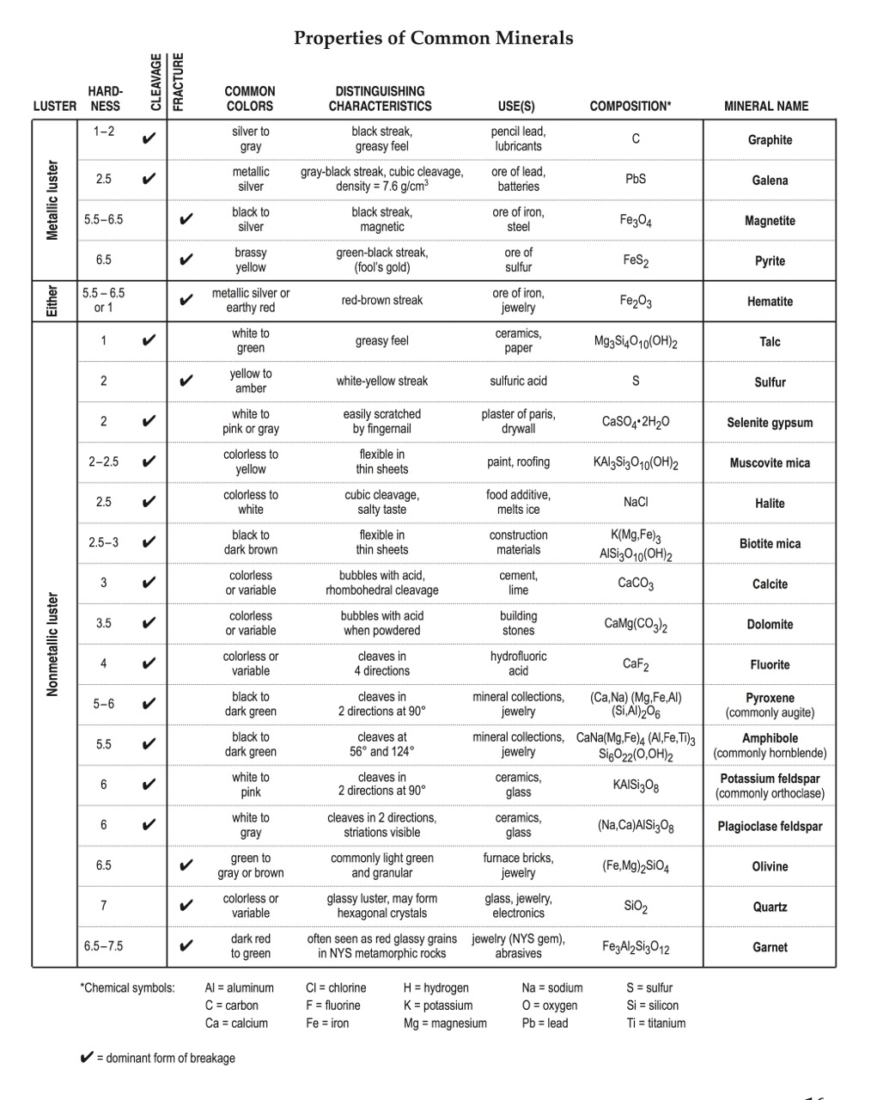

Slide 7
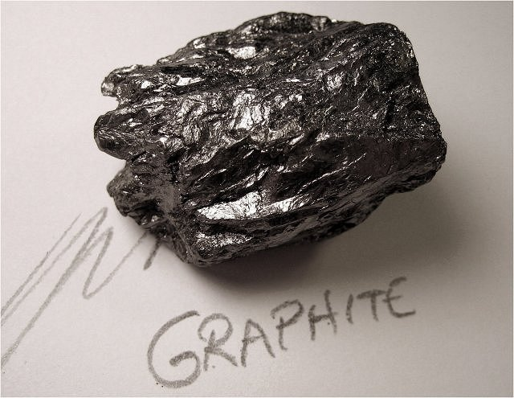

Slide 8
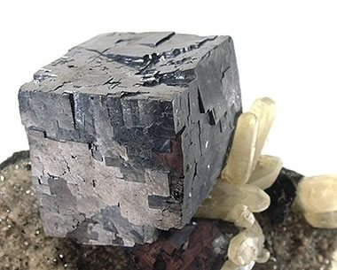

Slide 9
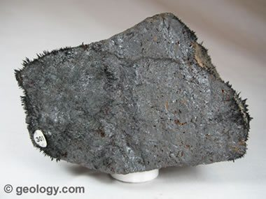

Slide 10
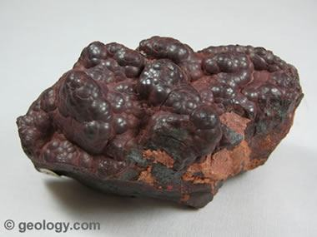

Slide 11
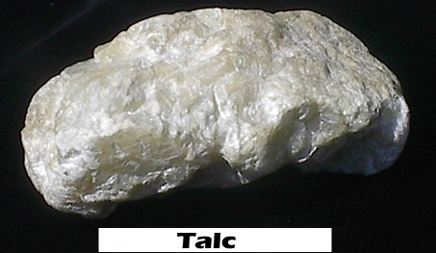

Slide 12
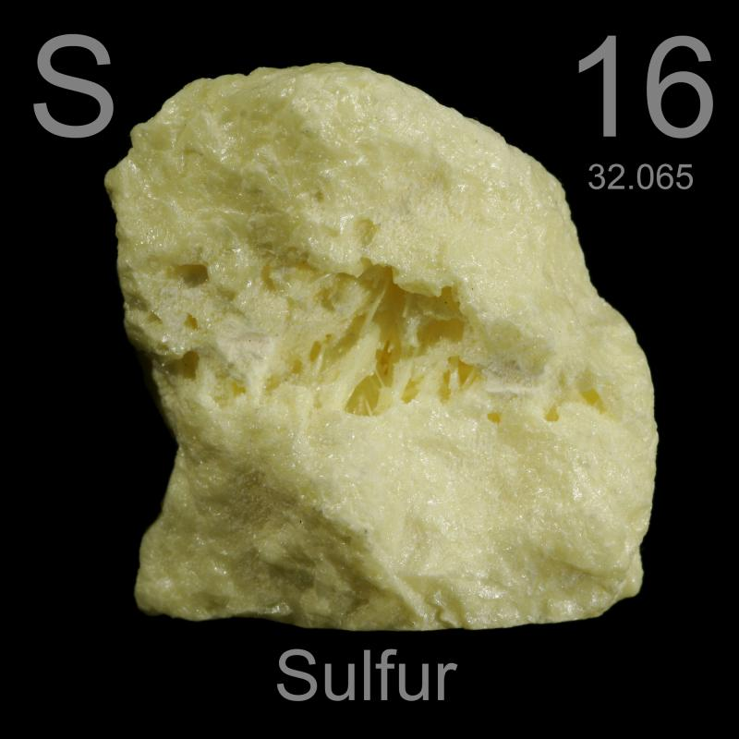

Slide 13
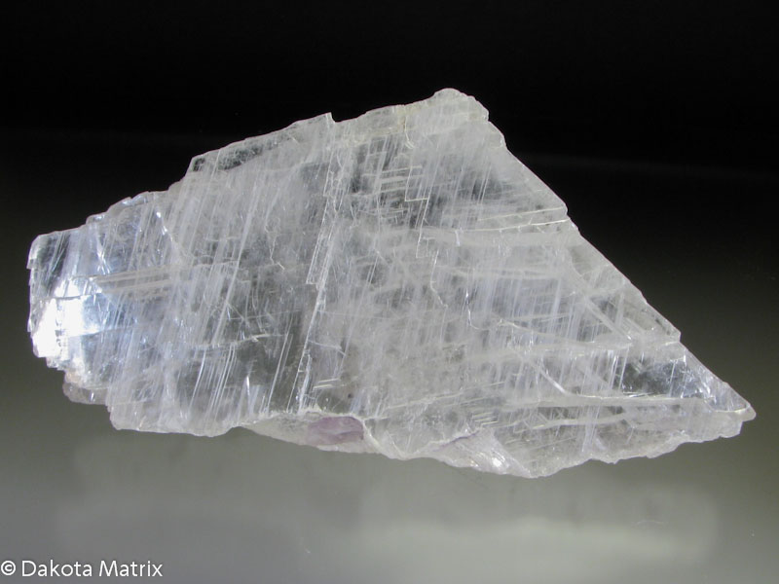

Slide 14
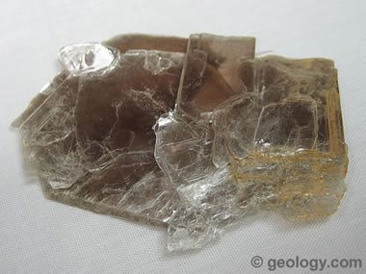

Slide 15
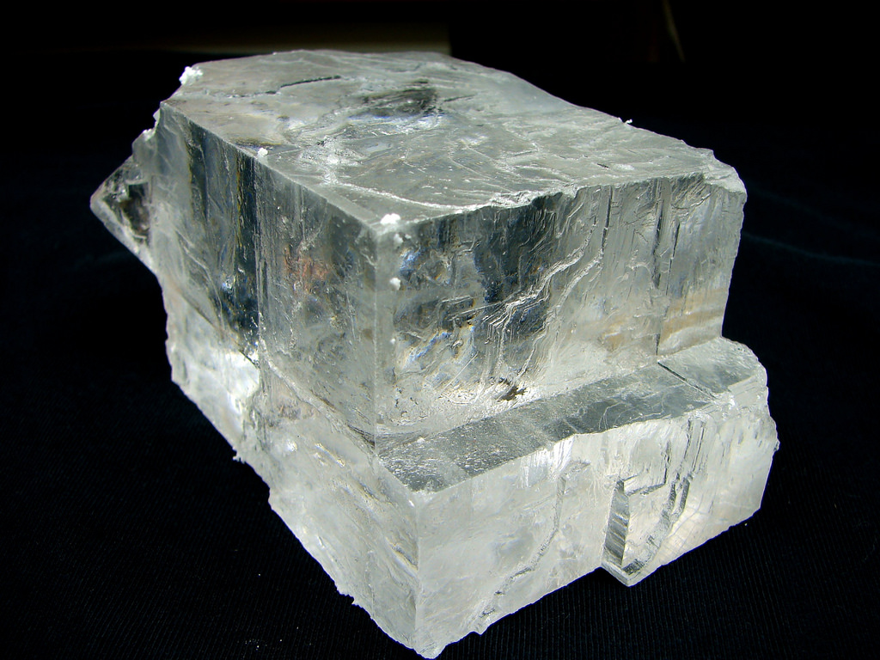

Slide 16
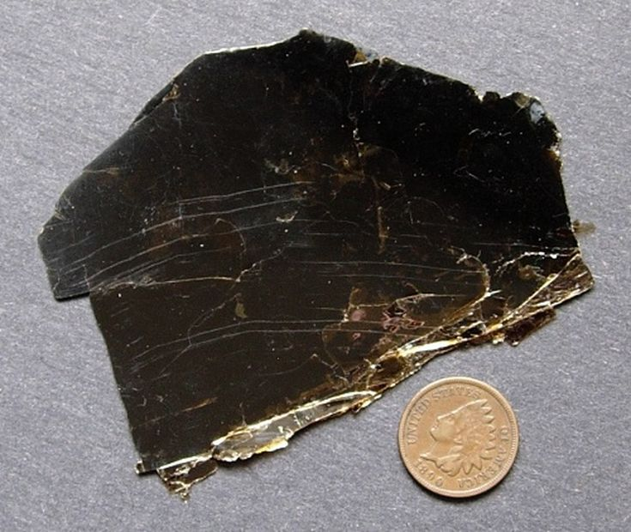

Slide 19
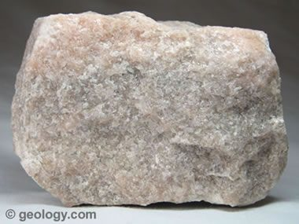

Slide 20
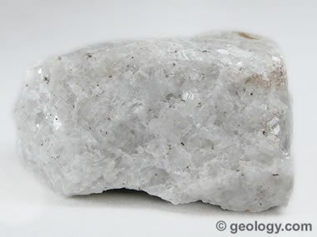

Slide 21
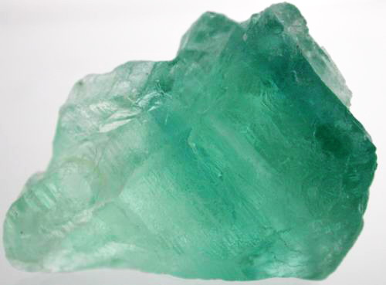

Slide 22
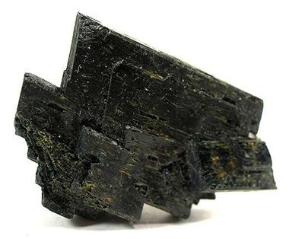

Slide 23
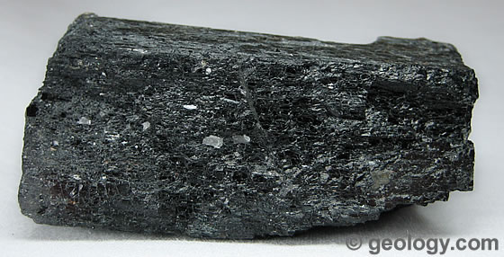

Slide 24
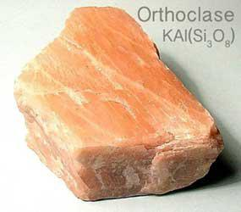

Slide 25
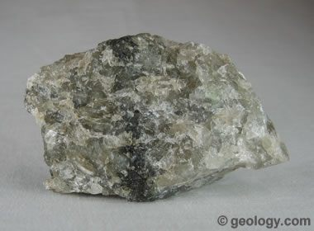

Slide 27
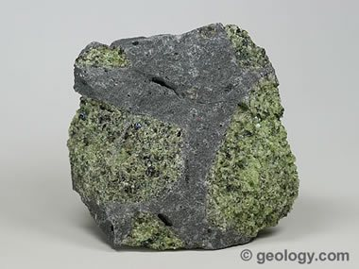

Slide 28
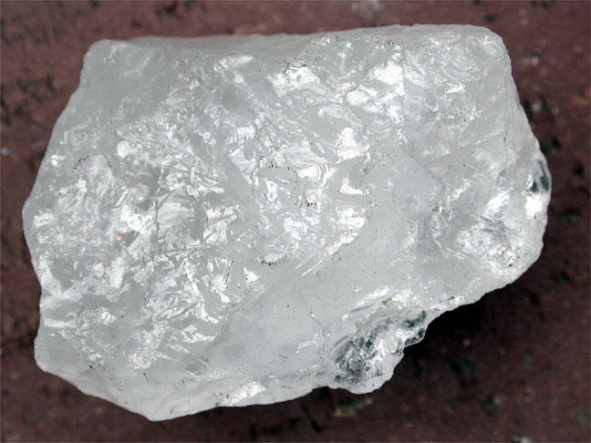

Slide 29
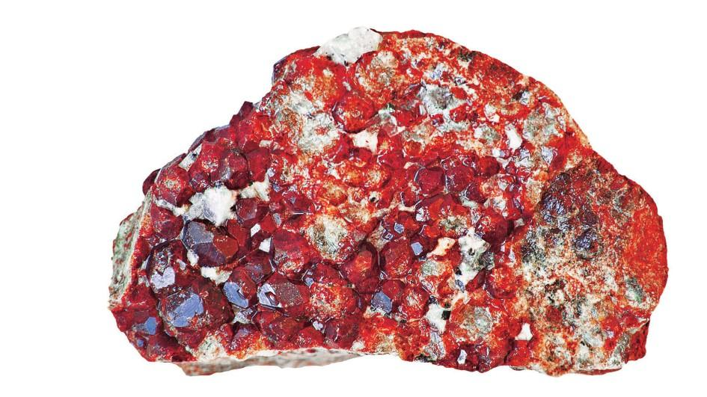

Slide 30
Variations in composition,
  Chemical composition can vary slightly depending on the temperature at which the mineral formed,
  This can affect how the mineral looks.

Slide 31
Of the 3,000 minerals, only about 30 of them are common in rocks.
Of these 8-10 are referred to as rock forming minerals because they make up most of the rocks on Earth’s crust.

Slide 32
Minerals from Magma
Molten material that forms and accumulates below Earth’s surface is called magma.
Magma is less dense than the surrounding rock and can rise up to the surface.
Magma that makes it to the surface is called lava.
The rate at which magma cools affects the size of the crystals inside of it.

Slide 33
Magma that cools slowly within Earth’s surface has time to develop large crystals.
Magma that reaches Earth’s surface or comes in contact with water (lava) it cools quickly and it does not have time to form crystals.

Slide 34
Minerals from Solutions
Minerals are often dissolved in water.
For example, ocean water evaporates and forms salt.
Saturated liquid – when a liquid becomes full of a dissolved substance and no more substance can dissolve in it.
Minerals that form from evaporation are called evaporites.

Slide 35
Identifying Minerals
Minerals are identified by physical and chemical properties
  Crystal form
  Luster
  Hardness
  Cleavage or Fracture
  Streak
  Color
  Texture
  Density

Slide 36
Crystal Form
Some minerals have distinct crystal shapes and are easily recognizable.
For example, halite (table salt) forms perfect cubes.

Slide 37
Luster
Luster – the way a mineral reflects light off its surface.
Metallic luster reflects light like a shiny metal.
Nonmetallic luster reflects light in a dull, pearly, waxy-like look.

Slide 38
Hardness
Hardness is the measure of how easily a mineral can be scratched.
One of the most reliable tests.
Developed by a German scientist – Freidrich Mohs.
Compares the relative hardness of 10 minerals.

Slide 39
Hardness of Common Objects
Fingernail – 2.5
Copper Penny – 3.5
Iron Nail – 4.5
Glass – 5.5
Streak Plate – 6.5 – 7

Slide 40
Cleavage or Fracture
Atomic arrangements determines how a mineral will break.
Mineral break along planes where atomic bonding is weak.
A mineral that splits easily and evenly along one or more flat planes is called cleavage.

Slide 41
Fracture
Minerals that break unevenly along rough, jagged edges is called fracture.
Some minerals break in an arc-like pattern that is called a conchoidal fracture.

Slide 42
Streak
When a mineral is rubbed across an unglazed porcelain plate it will sometimes leave a powdered streak on the surface of the plate.
Streak is the color of the powdered form of the mineral

Slide 43
Color
Color is the visual appearance of the mineral.
Color is the result of trace elements present when the mineral formed.
Color is an unreliable method of identifying minerals because the same mineral can have different colors.

Slide 44
Special Properties
Some minerals have unique properties that aid in identification.
Magnetism, double refraction, fluorescence, bubbles with hydrochloric acid.

Slide 45
Texture
Texture is how a mineral feels.
Some minerals may feel smooth.
Talc may feel greasy.
Texture is used with other tests during identification.

Slide 46
Density and Specific Gravity
Two minerals of the same size may have different weights due to the arrangement of the internal atoms.
Density = mass/volume
D = m/v
Specific gravity is the ratio of a mass of a mineral to an equal mass of water at 4˚C.

Slide 47
Section 2 – Types of Minerals
Essential Questions:
  What are the major mineral groups?
  How is the silicon-oxygen tetrahedron illustrated?
  How are mineral used?

Slide 48
Mineral Groups
Elements combine many different ways and proportions creating different types of minerals.
These minerals can be placed into groups based on their chemical nature and specific characteristics.

Slide 50
Section 2 – Types of Minerals
Essential Questions:
  What are the major mineral groups?
  How is the silicon-oxygen tetrahedron illusrated?
  How are minerals used?

Slide 51
Silicates
Oxygen is the most abundant element in Earth’s crust.
Elements that contain oxygen and silicon are known as silicates.
Silicates make up about 96% of Earth’s minerals.
Quartz and feldspar are silicates.

Slide 52
Tetrahedron is a geometric solid having 4 sides that are equilateral triangles.
Silicon has 4 valence electrons which allows it to bond easily with oxygen which has 7 electrons.

Slide 53
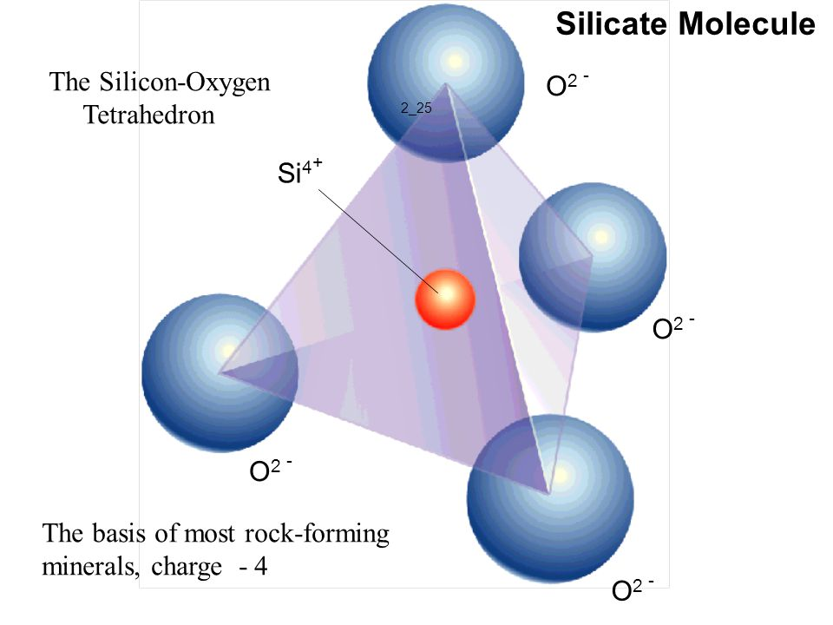

Slide 54
Carbonates
Oxygen combines easily with other elements and forms other mineral groups.
Carbonates are minerals composed of one of more metallic elements and the carbonate ion CO₃²ˉ
Examples of carbonates are calcite and dolomite

Slide 55
Oxides
Oxides are compounds with oxygen and a metal.
Hematite and magnetite are common oxides.

Slide 56
Other Groups
Sulfides such as pyrite.
Sulfates such as anhydrite.
Halides such as halite.
Native elements such as gold, silver, copper, nickel, etc. is made up of only one element.

Slide 57
Ores
A mineral is an ore if it contains a valuable substance the can be mined for profit.
Hematite is an ore because it contains the element iron.

Slide 58
Mines
Ores are located deep within Earth are removed by mining.
Overburden, unwanted rocks and minerals are removed to get at the desired mineral.

Slide 59
Gems
Gems are valuable minerals that are prized for their rarity and beauty.
They are very hard and scratch resistant
Gems are rubies, emeralds, and diamonds.

