Slide 1
Chapter 3 - Minerals
Section 1: What is a mineral?
Section 2: Types of Minerals

Slide 2
Section 1: Minerals are naturally occurring, solid, inorganic compounds or elements.
Section 2: Minerals are classified based on their chemical properties and characteristics.

Slide 3
Lesson 1 – Essential Questions
How are atoms and their components described?
How are the energy levels of atoms related to the chemical properties of elements?
What are isotopes?

Slide 4
Lesson 1 - Matter
Matter is anything that has volume and takes up space.
Everything around us in the physical world is matter.
On Earth, matter usually occurs as a solid, liquid, or gas.
All matter is made up of substances called elements.

Slide 6
Element is a substance that cannot be broken down into simpler substances by physical or chemical means.
Gold and lead are elements but they have different physical properties.
But both are made up of atoms.
All atoms consist of smaller particles.

Slide 7
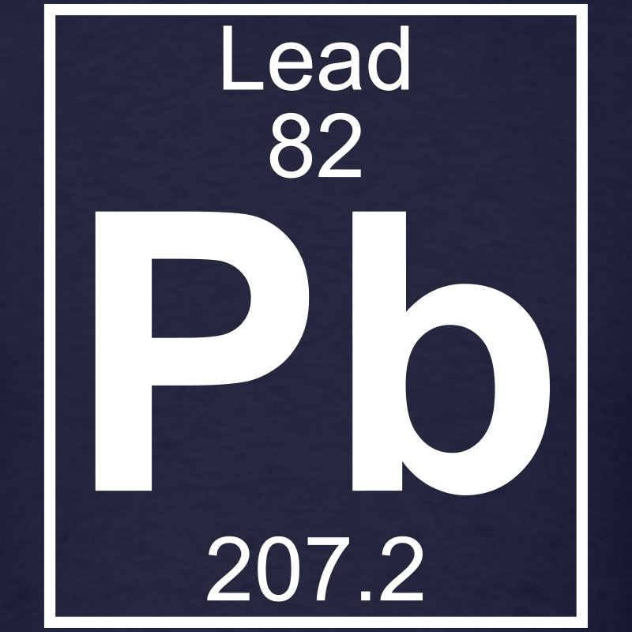

Slide 8
The center of the atom is called the nucleus.
The nucleus contains smaller particles called protons and neutrons.
A proton is a tiny particle that has a mass and a positive charge.
A neutron is a tiny particle that has a mass and has no charge.
The nucleus has a positive charge.

Slide 10
Surrounding the nucleus of a atom are smaller particles called electrons.
Electrons have little mass and a negative charge.
The electrons orbit the nucleus in a cloud-like region.
The overall charge of an atom is zero – +1-1+0=0

Slide 12
Periodic Table of Elements
There are 92 elements that occur naturally on Earth and the stars.
There are other elements that have been created in laboratories.
They are all arranged on the periodic table of elements.

Slide 14
Each element is identified by a one, two, or three letter abbreviation known as a chemical symbol.
The abbreviation is of the elements English or Latin name.
All of the elements are arranged by their chemical properties.
Elements that behave the same are together.

Slide 15
Atomic number is the number of protons in an atom’s nucleus.
Mass number is the sum of the protons and neutrons.
Isotopes are atom of the same element that have the same number of protons but a different number of neutrons.

Slide 16
Atomic Number
Chemical Symbol
Chemical Name
Atomic Mass

Slide 17
https://www.youtube.com/watch?v=GFIvXVMbII0
https://www.youtube.com/watch?v=1cqauZq4uYM

Slide 18
Isotopes tend to be radioactive.
Electrons move around in the “cloud” to different energy levels.
Electrons that are closest to the outside are called valence electrons.
These electrons are responsible for reactions.
All elements want to have 8 valence electrons to “be happy”

Slide 19
An element that gains or loses an electron is called an ion.
If it loses an electron it becomes positively charged.
If it gains an electron it becomes negatively charged.

Slide 20
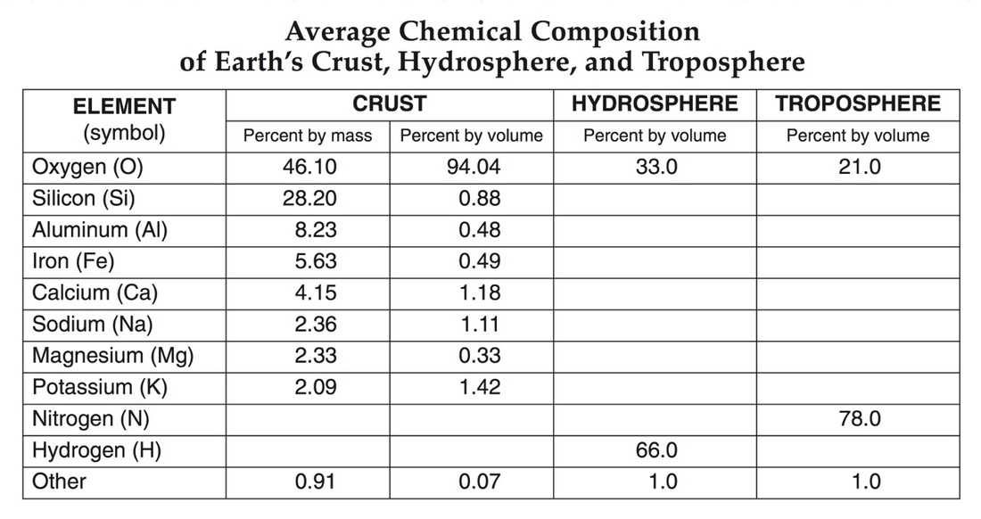
Oxygen is the most abundant element in Earth’s crust. (ESRT page 1)

Slide 21
Section 2 – Essential Questions
What are the different types of chemical bonds that unite atoms to form compounds?
How is the nature of chemical bonds that hold compounds together related to the physical structures of compounds?
What are the different types of mixtures and solutions?

Slide 22
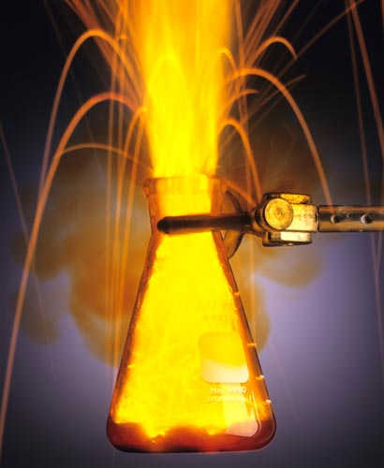
Section 2 – Combining Matter
Sodium
Na
Chlorine
Cl
Explodes in Water
Deadly Gas

Slide 23
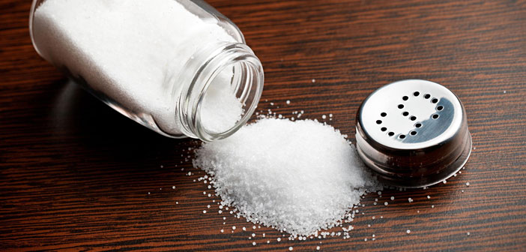
Produces
NaCl
Table Salt

Slide 24
Chemical Formulas
Compounds are represented by chemical formulas.
These formulas include the symbol for each element and the number of that atom in the compound.
The chemical formula for water is H₂O which means there are 2 hydrogen atoms and 1 oxygen atom.

Slide 25
Chemical Bonds
A chemical bond is a force that holds the elements in a compound together.
A covalent bond where 2 atoms share electrons.
A molecule is composed of two or more atoms held together by covalent bonds (weak bonds)
Ionic bonds are attractions between two ions of opposite charges (strong bonds)

Slide 26
Most compounds on Earth are held together by metallic bonds.
This allows metals to conduct electricity.
This allows metals to be deformed

Slide 27
Mixtures and Solutions
Mixture is a combination of two or more components.
Heterogeneous mixture is a mixture where you can recognize and separate the parts.
Example – a mixed salad
Homogeneous mixture is a mixture where the parts can’t be separated.
Example – chocolate milk

Slide 28
Solution is a homogeneous mixture.
A solution can be a solid, liquid, or gas.

Slide 29
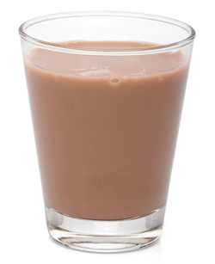

Slide 30
Acids
An acid is a solution containing a substance the produces H atoms in water.
The pH scale measures the hydrogen ions in a substance.
pH of less than 7 is acidic
pH of more than 7 is basic

Slide 31
The most common acid in Earth is carbonic acid (H₂CO₃)
It is produced by the following reaction:
Water + Carbon Dioxide Carbonic Acid
H₂O + CO₂ H₂CO₃

Slide 32
Water and carbon dioxide causing limestone to break down and form a cave.
It might take thousands of years but will eventually change Earth.

Slide 34
Section 3 – Essential Questions
What are the different states of matter on Earth?
Why does matter exist in these states?
How is thermal energy related to changes in the states of matter?

Slide 35
Section 3 – State of Matter
Solids are substances with densely packed particles.
Most solids are crystalline structures because the particles are arranged in a regular pattern.
Most rocks on Earth are polycrystalline solids.
Polyscrystalline solids is a mass of intergrown crystals.
Glass has a random pattern of atoms.

Slide 36
The particles in a liquid can move past each other.
The liquid will take the shape of the container.
Liquids have a definite volume but no definite shape.

Slide 37
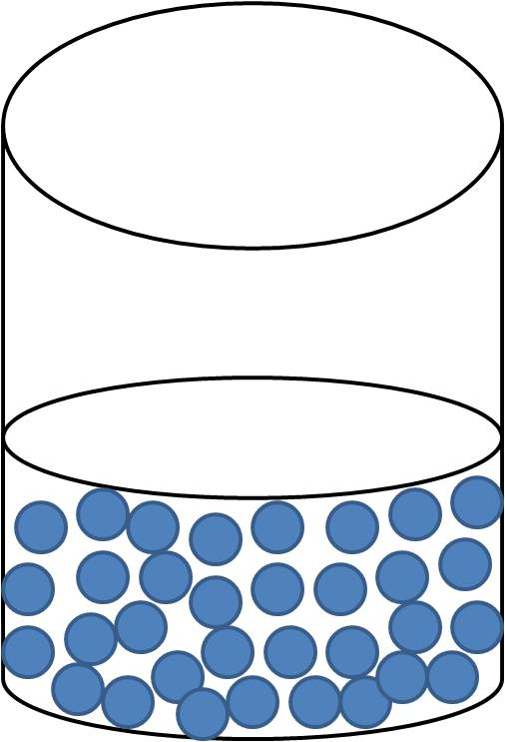

Slide 38
Gases form when a liquid reaches the boiling point when evaporation occurs.
The particles of a gas are widely spaced and move around quickly.
Gases have no definite shape or volume. They will take the space of the container.
Plasma occurs when matter is heated above 5000°C.
Plasma occurs on the Sun and in lightning.

Slide 40
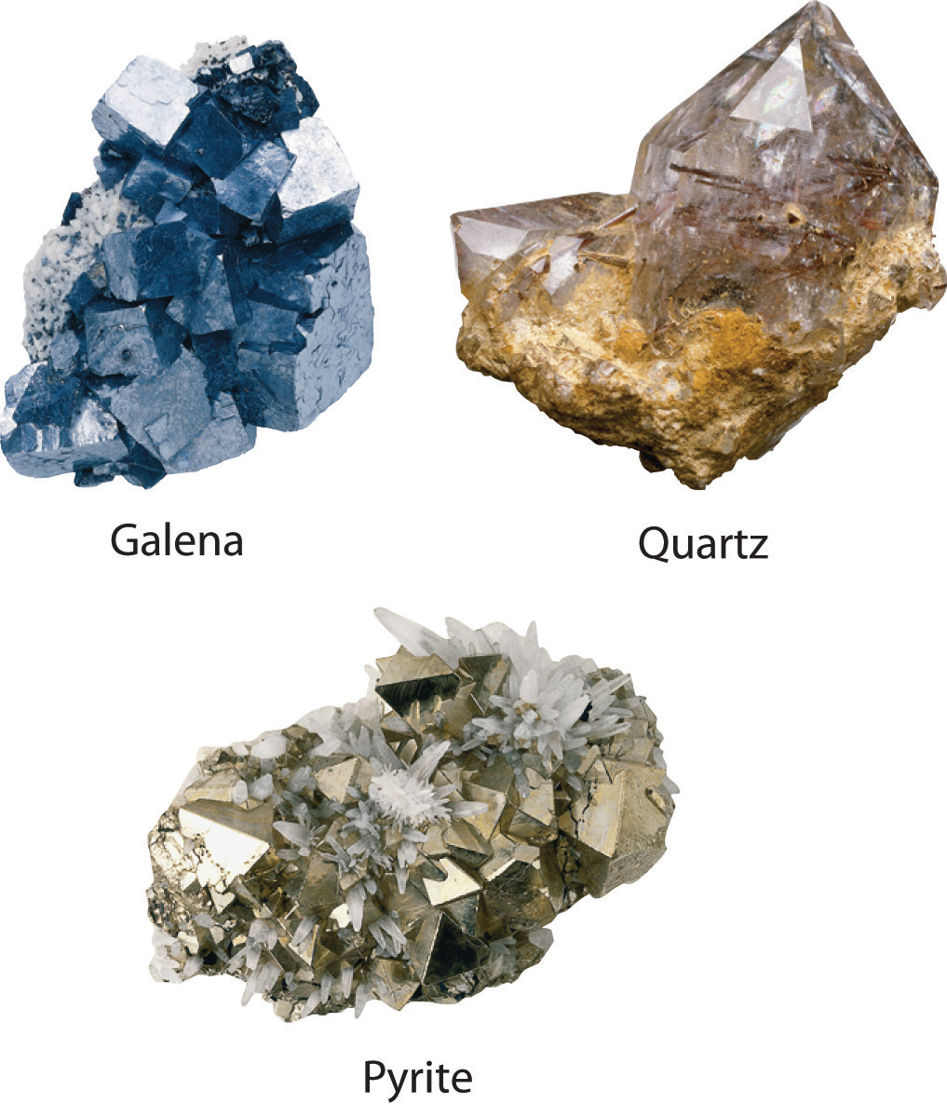

Slide 41
Changes of State
A solid melts when it absorbs enough thermal energy to break apart the particles.
This is the melting point.
A liquid becomes a solid when it becomes cooled and releases thermal energy.
When a liquid is heated to boiling point it absorbs enough thermal energy to become a gas.

