Slide 1
Stars
Section 1: The Sun
Section 2: Measuring the Stars
Section 3: Stellar Evolution

Slide 2
Section 1: The Sun contains most of the mass of the solar system and has many features typical of other stars.
Section 2: Stellar classification is based on measurement of light spectra, temperature, and composition.
Section 3: The Sun and other stars follow similar life cycles, leaving the galaxy enriched with heavy elements.

Slide 3
Section 1 – The Sun
Essential Questions:
Wat are the layers and features of the Sun?
How is the process of energy production on the Sun explained?
How are the three parts of spectra defined?

Slide 4
The Sun is the largest object in the solar system.
It would take 109 Earths lined up edge to edge, to fit across the Sun.
The Sun contains 99 percent of the mass of the solar system.
The density of the Sun is about 13 times the density of lead.

Slide 5
Due to the Sun’s extremely high temperature, all the gases are ionized into a state of matter called plasma.
The Sun is organized into layers and each one emits energy at wavelengths resulting from temperature.

Slide 6
Photosphere
The photosphere is the visible surface of the Sun.
It is approximately 400 km thick and a temperature of 5800K.
It is the innermost layer and most of the visible light comes from this layer.
The 2 outermost layers are transparent.

Slide 7
Chromosphere
Located outside of the photosphere, the chromosphere is approximately 2500km thick and has an average temperature of 15000K.
Usually the chromosphere is only visible during a solar eclipse when the photosphere is blocked.
The chromosphere appears red.

Slide 8
Corona
The outermost layer is called the corona.
It extends several million kilometers from the outside edge of the chromosphere.
It usually has a temperature of about 3-5 million K.
Most light from this area is ultraviolet or x-rays.

Slide 9
Solar Wind
The corona does not have an edge.
Plasma flows from the corona at high speeds and forms solar winds.
Streams of the solar wind moves at 300-800 km/s.
The particles are deflected by Earth’s magnetic field and causes the gases to give off light called the aurora.

Slide 10
Solar Activity
The Sun’s magnetic field disturbs the solar atmosphere and causes new features to appear.
Sunspots are dark spots on the surface of the photosphere.
Sunspots are bright but they appear darker than the surrounding area because they are cooler.

Slide 11
Scientists have observed that the number and pattern of sunspots are predictable.
The sunspot cycle takes about 11 years to complete.
Solar flares are violent eruptions of particles and radiation from the surfaces of the Sun.
Often the particles escape the surface of the Sun in the solar wind.

Slide 12
The largest solar flare occurred in November 2003 and hurled particles from the Sun’s surface at 9 million km/h.
A prominence is an arc of gas that is ejected from the chromosphere and rains back to the surface.
Prominences can last a few hours to a few months.

Slide 13
The Solar Interior
Fusion occurs in the core of the Sun where the pressure and temperature are extremely high.
Fusion is the combination of lightweight, hydrogen atomic nuclei into heavier nuclei such as helium.

Slide 14
The quantity of energy that arrives on Earth everyday from the Sun is enormous.
About 13 100W light bulbs could operate with the energy that reaches the ground in 1 second.

Slide 15
Section 2 – Measuring the Stars
Essential Questions:
How are distances between stars measured?
What is the difference between brightness and luminosity?
What are the properties used to classify stars?

Slide 16
Patterns of Stars
Long ago, many civilizations looked at the stars and named groups of them after animals, mythological creatures, or everyday objects.
These groups of stars are called constellations.
Even though stars in a constellation appear close to each other they are 100 to 200 trillion miles from Earth.

Slide 17
Stellar Positions and Distances
Astronomers use two units to measure long distances.
One is a light-year (ly).
A light-year is the distance that light travels in one year or 9.461 X 10¹² km.
A parsec (pc) is equal to 3.26ly or 3.086 X 10¹³km

Slide 18
Basic Properties of Stars
The basic properties of a star mass, diameter, and luminosity.
Temperature is another property.
Temperature controls the nuclear reaction rate and governs the luminosity.
Apparent magnitude is how bright the star appears.

Slide 19
Absolute magnitude is how bright a star would appear if it were placed at a distance of 10pc.
Luminosity is the measure of the energy output from the surface of the star per second.
The Sun’s luminosity if about 3.85 X 10²⁶ W.

Slide 20
Stars are assigned spectral types in the following order:
O, B, A, F, G, K, and M
Each class is subdivided into more specific divisions from 0 to 9.
O stars are the hottest and M stars the coolest.
The Sun is a G2 star

Slide 21
NYS ESRT Star Classification
The chart describes the characteristics of the stars.
Hertzprung-Russell (H-R) Diagram where absolute magnitude is plotter on the vertical axis and temperature is plotted on the horizontal axis.
Most stars occupy the region in the diagram called the main sequence.

Slide 22
About 90% of the stars, including the Sun are main sequence.
Red giants are large, more than 100 times the Sun, cool, and luminous.
White dwarfs are small, dim, hot stars.
A white dwarf is about the size of Earth but has a mass as large as the Sun.

Slide 23
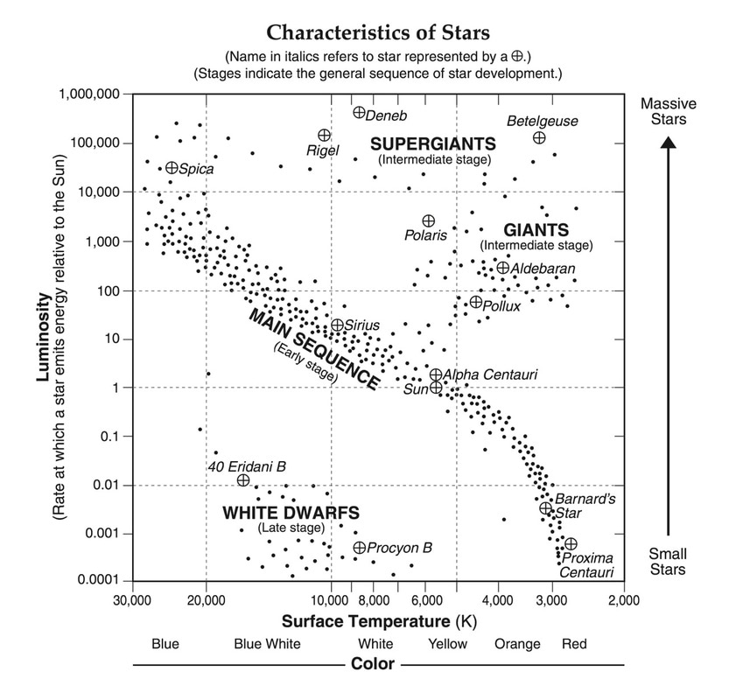

Slide 24
Section 3 – Stellar Evolution
Essential Questions:
What is the relationship between mass and star’s evolution?
What are the features of massive and regular star cycles?
How is the universe affected by the life cycles of stars?

Slide 25
Mass governs a star’s temperature, luminosity, and diameter.
The more massive a star is, the greater the gravity pressing inward, and the hotter and more dense the star must be inside to balance its own gravity.
The temperature inside a star governs the rate of nuclear reactions which in turn determines the star’s output

Slide 26
All stars form in much the same manner as the Sun did.
The formation of a star begins with a cloud of interstellar gas and dust called a nebula, which collapses on itself as a result of its own gravity.
As the cloud contracts, its rotation forces it into a disk shape with a hot, condensed object at its center called a protostar.

Slide 27
Friction from the gravity continues to increase the temperature of the protostar, until the condensed object reaches the ignition temperature for nuclear reactions and becomes a star.
It takes about 10 billion years for a star with the mass of the Sun to convert all of the hydrogen into helium.

Slide 28
Black Holes
Is a small, extremely dense object that remains is called a black hole because its gravity is so immense that nothing, not even light, can escape it.

