Slide 1
The Sun-Earth-Moon System
Section 1: Tools of Astronomy
Section 2: The Moon
Section 3: The Sun-Earth-Moon System

Slide 2
Section 1: Radiation emitted or reflected by distant objects allows scientists to study the universe.
Section 2: The Moon, Earth’s nearest neighbor in space, is unique among the moons in our solar system.
Section 3: Motions of the Sun-Earth-Moon system define Earth’s day, month, and year.

Slide 3
Section 1 – Tools of Astronomy
Essential Questions:
What is electromagnetic radiation?
How do telescopes work?
How does space exploration help scientists learn about the universe?

Slide 4
Radiation from distant bodies throughout the universe is called electromagnetic radiation.
Electromagnetic radiation includes visible light, infrared, ultraviolet radiation, radio waves, microwaves, X-rays, and gamma rays.

Slide 5
Telescopes give us the ability to observe wavelengths beyond what the human eye can detect.
Refracting telescopes use lenses to bring visible light to focus.
Reflecting telescopes use mirrors to bring visible light to focus.
Radio telescopes collects the longer wavelengths of radio waves with a large dish.

Slide 6
Data is converted into visual images in a process called interferometry.
Space-based astronomy uses telescopes in space that eliminates the interference caused by our atmosphere.
Hubble Space Telescope was launched in 1990 to obtain sharp visible-light images.
The Hubble has observed galaxies over 12 billion light years away.

Slide 7
The James Webb Telescope will be launched in 2018 to observe galaxies in the infrared range.
Probes are used to explore distant planets by landing on them.

Slide 8
Section 2 – The Moon
Essential Questions:
What is the history of lunar exploration?
How are lunar properties and structures described?
What are the features of the moon?
What is the theory of the Moon’s origina and formation?

Slide 9
Astronomers have learned much about the Moon from observations but mostly from human exploration.
The Moon is the brightest object in our night sky.
It reflects only about 7 percent of the sunlight that hits its surface. (The Earth reflects 31%)

Slide 10
Since the Moon absorbs so much sunlight it has extreme temperatures.
In sunlight the Moon’s surface will reach temperatures of 127°C.
In the unlit portion temperatures will reach -233°C.

Slide 11
Highlands are heavily cratered regions of the Moon that are light in color and mountainous.
Maria are dark, smooth plains.
Rilles are valleylike structures that are collapsed lava tubes.
Impact craters are formed when objects from space crashed into the lunar surface.

Slide 12
Material that is blasted out of the impact crater and falls back to the lunar surface is called ejecta.
Some craters have long ejecta called rays that radiate outward like spokes on a bicycle tire.
The Moon is made up of minerals similar to Earth.

Slide 13
The Moon is between 3.8 and 4.6 billion years old.
The Moon was heavily bombarded during its first 800 million years.
The bombardment broke up the surface rocks that resulted in a layer of loose, ground-up rock called regolith.
The Moon has a layered structure similar to Earth.

Slide 14
According to the giant impact theory, the Moon formed as the result of a collision between Earth and Mars-sized object about 4.5 billion years ago when the solar system was forming.
The impact caused debris to be ejected but kept within Earth’s gravitational field.
The debris eventually formed a satellite that remains in orbit around Earth.

Slide 15
Section 3 – The Sun-Earth-Moon System
Essential Questions:
What are the relative positions and motions of the Sun, Earth, and Moon?
What are the phases of the Moon?
What are the differences between solstices and equinoxes?
How are the eclipses of the Sun and Moon explained?

Slide 16
The Sun rises in the east and sets in the west.
So do the planets, the Moon, and stars.
These motions result from the Earth’s rotation.
One way to show that the Earth is rotating is to use a Foucault pendulum.
A pendulum swings in a constant direction but as the Earth turns under it the pendulum seems to change direction.

Slide 17
Foucault Pendulum
https://www.youtube.com/watch?v=iqpV1236_Q0

Slide 18
A second way is to observe the way Earth is diverted from a north-south direction to an east-west direction.
This is called the Coriolis effect.

Slide 19
Earth orbits the Sun in a slightly elliptical orbit.
The plane of Earth’s orbit is called the elliptic plane.
As Earth rotates, the Sun and planets appear to move across the sky in a path known as the elliptic.
As Earth moves in its orbit different constellations are visible.

Slide 20
Earth’s axis is tilted relative to the elliptic at approximately 23.5°.
As the Earth orbits the Sun the Earth’s axis remains fixed in space.
For six months the northern hemisphere is tilted towards the sun and for the other six months it is tilted away from the Sun.
The seasons are caused by the tilt and Earth’s orbit.

Slide 21
Do these Harvard students have what causes the seasons correct?
https://www.youtube.com/watch?v=p0wk4qG2mIg

Slide 22
At a solstice (summer or winter), the Sun is overhead at its farthest distance either north or south of the equator.
The Tropic of Cancer (23.5N) and the Tropic of Capicorn (23.5S) are these points.
On the first day of summer in the northern hemisphere the Sun is directly overhead at noon at The Tropic of Cancer.

Slide 23
When the Earth is midway between the solstices the Earth is at equinox (equal night).

Slide 24
The Seasons Explained
https://www.youtube.com/watch?v=KUU7IyfR34o

Slide 25
Phases of the Moon
We always see the same side of the Moon because of synchronous rotation, the state at which orbital and rotational periods are equal.
The length of time it takes for the Moon to go through a complete cycle of phases.
The length of a lunar month is 29.5 days.

Slide 26
Phases of the Moon
https://www.youtube.com/watch?v=NCweccNOaqo
https://www.history.com/shows/the-universe/videos/phases-of-the-moon

Slide 27
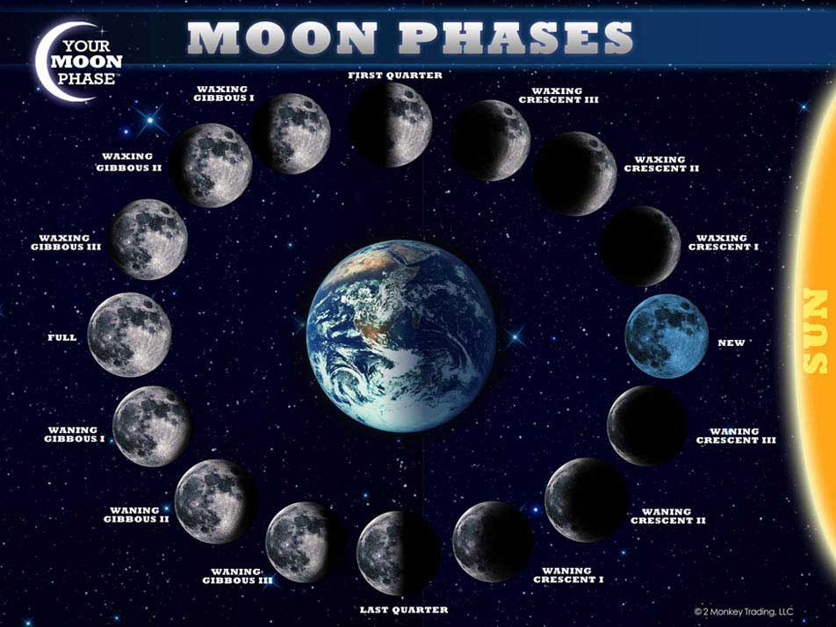

Slide 28
Tides
One effect the Moon has on Earth is causing ocean tides.
The Moon’s gravity pulls on Earth and this creates bulges of ocean water on both the near and far sides of Earth.
As the Earth rotates these bulges remain aligned with the Moon so that the ocean level rises and falls every 12 hours.

Slide 29
Spring tides are high tides higher than normal.
This caused when the Sun and Moon are aligned in the same direction.
When the Sun and Moon are at right angles this results in a neap tide – a high tide that is lower than usual.

Slide 30
Solar Eclipses
A solar eclipse occurs when the Moon passes directly between the Sun and Earth and blocks the Sun from view.
A total solar eclipse occurs when the Moon blocks out the entire Sun.
A partial solar eclipse occurs when the Moon blocks only a portion of the Sun.

Slide 31
Lunar Eclipse
A lunar eclipse occurs when the Moon passes behind Earth in relation to the Sun.
This can only happen when the Moon is full.

