Slide 1
Fossils and the Rock Record
Section 1: The Rock Record
Section 2: Relative-Age Dating
Section 3: Absolute-Age Dating
Section 4: Fossil Remains

Slide 2
Section 1: Scientists organize geologic time to help them communicate about Earth’s history.
Section 2: Scientists use geologic principles to learn the sequence in which geologic events occurred.
Section 3: Radioactive decay and certain kinds of sediments help scientists determine the numeric age of many rocks.
Section 4: Fossils provide scientists with a record of the history of life on Earth.

Slide 3
Section 1 – The Rock Record
Essential Questions:
Why do scientists need a geologic time scale?
How are eons, eras, periods, and epochs defined?
What are the groups of plants and animals that dominated the eras of Earth’s history?

Slide 4
Organizing Time
A hike down the Grand Canyon reveals the multicolored layers of rock, called strata, that make up the canyon walls.
By studying rock layers and the fossils within them, geologists can reconstruct aspects of Earth’s history and interpret ancient environments.
To help in the analysis of Earth’s rocks, geologists have divided Earth’s history into time units.

Slide 5
Explore the rocks of the Grand Canyon.
https://www.nature.nps.gov/views/layouts/Main.html#/GRCA/geo/dep/

Slide 6
The time units are part of the geologic time scale.
The geologic time scale is a record of Earth’s history from its origin 4.6 billion years ago (bya) to the present.
The time scale is divided into units called eons, eras, periods, and epochs.

Slide 7
Eon is the largest part of the time units and encompasses the others.
From oldest to youngest:
Hadean
Archean
Proterozoic
Phanerozoic

Slide 8
The three earliest eons make up 90 percent of geologic time known as the Precambrian.
During the Precambrian the Earth was formed and became hospitable to life.
Each time unit is represented by new life forms.

Slide 9
Eras are usually tens to hundreds of millions of years in duration.
The three eras of the Geologic Time Scale are:
Paleozoic (means “old-life”)
Mesozoic (means “middle-life”)
Cenozoic (means “recent life”)

Slide 10
Periods are generally tens of millions of years in duration.
Some periods are named for the geographic region in which the rocks or fossils were first observed.

Slide 11
Epochs are even smaller divisions of the geologic time scale.
Epochs are usually hundreds of thousands to millions of years.

Slide 13
During the Phanerozoic Eon, multicellular life diversified.
Trilobites dominated ocean life in the Paleozoic Era.
The end of the Paleozoic is marked by the largest mass extinction event in Earth’s history.
95% of all life became extinct.

Slide 14
Section 2 – Relative-Age Dating
Essential Questions:
How is uniformitarianism defined and what is its importance to geology?
What geologic principles are used to interpret rock sequences and determine relative ages?
What are the different types of unconformities and how do they differ?
How do scientists use correlation to understand the history of a region?

Slide 15
Earth’s history dates back billions of years however scientists did not always think Earth was that old.
James Hutton, a Scottish geologist who lived in the late 1700’s was one of the first scientists to think that the Earth was very old.
He developed principles to determine the age of the Earth.

Slide 16
Uniformitarianism states that geologic processes occurring today have been occurring since the Earth formed.

Slide 17
James Hutton information:
http://www.amnh.org/explore/resource-collections/earth-inside-and-out/james-hutton-the-founder-of-modern-geology/

Slide 18
Relative-age dating is the study of the order in which geologic events occurred.
Original horizontality is the principle that sedimentary rocks are deposited in horizontal layers.
Gravity, wind, and water spreads sediments evenly.

Slide 19
Superposition is a principle that states that in an undisturbed rock sequence, the oldest rocks are at the bottom and each subsequent layer is younger than the layer beneath it.

Slide 20
Cross-cutting relationships states that an intrusion is younger than the rock it cuts across.

Slide 21
The Principle of Inclusions states that the fragments, called inclusions, in a rock layer must be older than the rock layer that contains them.

Slide 22
Unconformities are buried surfaces of erosion.
Disconformity is when a horizontal layer of sedimentary rock overlies another horizontal layer of sedimentary rock that has eroded.

Slide 23
Nonconformity is when a layer of sedimentary rock overlies a layer of igneous or metamorphic rock.
A nonconformity indicates a gap in the rock record during which rock layers were uplifted, eroded, and new layers of sedimentary rocks formed on top.

Slide 24
Angular unconformity is when horizontal layers of sedimentary rock is laid on top of tilted, eroded layers.

Slide 25
Correlation is the matching of outcrops or fossils exposed in one geographic region and compared to other regions.
Key bed is a sedimentary rock layer used as a marker.
Fossil correlation is used to sequence sedimentary rock layers.

Slide 26
Section 3 – Absolute-Age Dating
Essential Questions:
What are the differences between absolute-age dating and relative-age dating?
How are radioactive elements used to date rocks and other objects?
How can scientists use certain non-radioactive material to date geologic events?

Slide 27
Radioactive Isotopes
Absolute-age dating enables scientists to determine the numerical age of rocks and other objects.
One type of absolute-age dating is the measure of the decay of radioactive isotopes.
Radioactive isotopes emit nuclear particles at a constant rate.
Radioactive decay is the emission of radioactive particles and the resulting change into other isotopes.

Slide 28
Radiometric dating is the method used to date an object.
Half-life is the measure of the length of time it takes for half of the parent material to decay.
After one half-life, 50% of the parent material remains.
Half-life is useful in dating metamorphic and igneous rocks.

Slide 29
Radiometric dating is not useful in dating sedimentary rocks because they are made of pieces of rocks that can be a variety of ages.
Radiocarbon dating is used to date organic material such as plant and animal material.
Radiocarbon dating is only used for material within the last 60,000 years.

Slide 30
Other ways to determine absolute age
Tree rings
Ice cores
Varves (bands of alternating light and dark colored sediments deposited in different seasons.

Slide 31
Section 4 – Fossil Remains
Essential Questions:
What are the methods by which fossils are preserved?
How do scientists use index fossils?
How are fossils used to interpret Earth’s past physical and biological history?

Slide 32
The Fossil Record
Fossils are the preserved remains or traces of once-living organisms.
They provide evidence of the past existence of a wide variety of life-forms.
Evolution is the change in species over time.
When geologists find fossils in rocks, they know that the rock is about the same age as the fossils.

Slide 33
Original preservation is the remains of plants of animals that have been altered very little since the organisms death.
Some examples are mammoths preserved in the ooze of the La Brea Tar Pit, woody part of plants in the permafrost in Alaskan bogs, or insects trapped in sap of trees that hardened into amber.

Slide 34
La Brea Tar Pits
https://www.nytimes.com/video/travel/1194817111771/la-brea-tar-pits.html

Slide 35
Altered hard parts are the most common type of fossil.
Hard parts such as shells and bones can become fossils.
In the process of mineral replacement the pore spaces of an organism’s buried hard parts are filled with minerals from groundwater.

Slide 37
Recrystallization can occur when a buried hard part is subjected to changes in temperature and pressure.
A mold forms when sediments cover the original hard part and the original hard part is removed by erosion or weathering.
The mold may later become filled with material to become a cast.

Slide 38
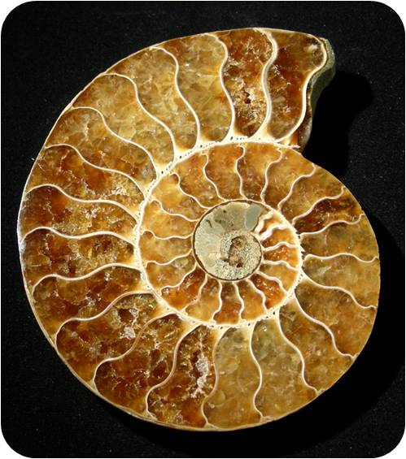
Recrystallization and Mold Fossils

Slide 39
Trace fossils include worm trails, footprints, and tunneling burrows.
Trace fossils include gastroliths (smooth rounded rocks from a dinosaurs stomach that help digest foods) and coprolites (solid waste materials from animals).
Scientists can determine what an ancient animal ate by analyzing coprolites.

Slide 41
Index fossils are fossils that are easily recognized, abundant, and widely distributed geographically, and lived for a short period of time.
If a geologist finds an index fossil in rocks she can determine the age of the sedimentary rock.

