Slide 1
Earthquakes
Section 1: Forces Within Earth
Section 2: Seismic Waves and Earth’s Interior
Section 3: Measuring and Locating Earthquakes
Section 4: Earthquakes and Society

Slide 2

Section 1: Faults form when the forces acting on rock exceed the rock’s strength.
Section 2: Seismic waves can be used to make images of the internal structure of Earth.
Section 3: Scientists measure the strength and chart the location of earthquakes using seismic waves.
Section 4: The probability of an earthquake’s occurrence is determined from the history of earthquakes and knowing where and how quickly strain accumulates.

Slide 3
Section 1 – Forces within Earth
Essential Questions:
  How are stress and strain defined as they apply to rocks?
  What are the three types of movement and faults?
  What are the three types of seismic waves?

Slide 4
Stress and Strain
Most earthquakes are the result of movement of Earth’s crust produced by plate tectonics.
Rocks in the crust want to resist movement but over time stress builds up.
When stress overcomes the strength of rocks, movement occurs.
There are three kinds of stress:
  Compression
  Tension
  Sheer

Slide 5
Compression is the stress that decreases the volume of the material.
Tension is the stress that pulls a material apart.
Shear is the stress that causes a material to twist.

Slide 6
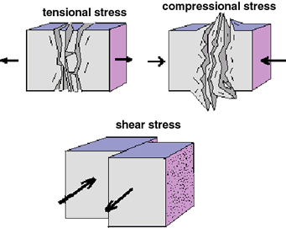

Slide 7
Strain is the materials response to stress.
When the stress and strain reach a critical point the rock will release energy.
The release of this energy results in an earthquake.
Rocks can respond to stress and strain.

Slide 8
Elastic deformation happens when rock is compressed, bent, or stretched.
This is like a rubber band being stretched.
When the energy is released, the rubber band returns to normal.
Plastic deformation happens when the stress builds up to a certain point.
This type of stress forms a permanent deformation, like a tear in the rubber band stretched too far.

Slide 9
Faults
Fault is any fracture or system of fractures along which Earth moves.
The movement along a fault results in earthquakes.
Reverse and normal, and strike-slip faults are three types of faults.

Slide 10
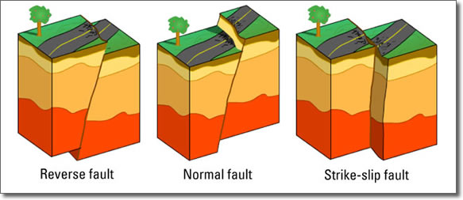

Slide 11
Earthquake Waves
As stress builds on rocks and it is released it is called an earthquake.
The vibrations of the ground produced by an earthquake are called seismic waves.
Every earthquake generates three types of seismic waves – primary, secondary, and surface waves.

Slide 12
Primary Waves
Also referred to as P-waves.
Primary (First)
Push and Pull rocks in the direction along which the wave travels (Perpendicular).
Fast (Phast)
Move through all Phases (solids, liquids, and gases).

Slide 13
Secondary Waves
Called S-waves.
Second set of waves.
Slower that P-waves.
Move up and down like a sideways S.
Moves through Solids.

Slide 14
Surface Waves
The third and slowest type which travel along Earth’s surface.
Cause the ground to move up and down like waves.
They are the most destructive because they cause the most movement of the ground and last the longest.

Slide 15
Focus of an earthquake is where the failure of rock originated within Earth.
The focus is usually several kilometers within Earth.
The epicenter is the point on Earth’s surface directly above the focus.

Slide 16
Section 2 – Seismic Waves and Earth’s Interior
Essential Questions:
  How does a seismometer work?
  How have seismic waves been used to determine the structure and composition of Earth’s interior?

Slide 17
Seismometers and Seismograms
Most vibrations caused by seismic waves are not felt but can be measured by sensitive instruments.
Seismometer is an instrument with a rotating drum covered with a sheet of paper, a pen, and a pendulum.
The shaking of the ground causes the pendulum to move.

Slide 18
The paper record produced by the seismometer is called a seismogram.

Slide 19
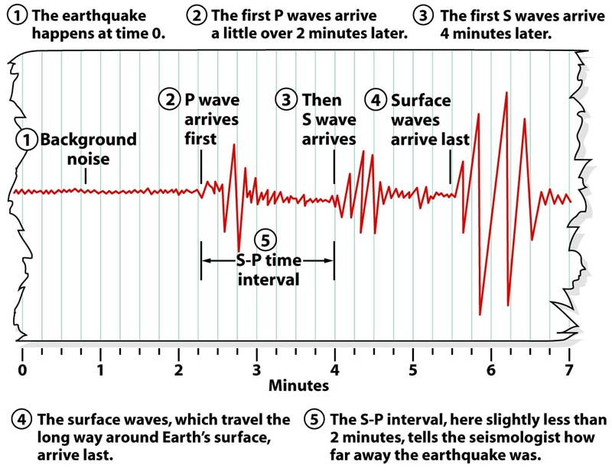
Seismogram

Slide 20
Travel-Time Curves
Travel-time curves show how long it takes for P-waves and S-waves to reach seismic stations from a earthquakes epicenter.

Slide 21
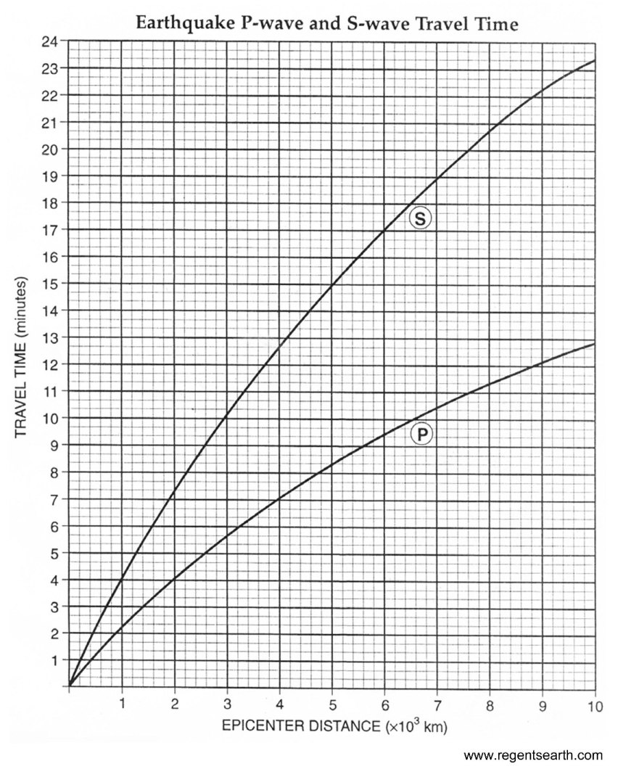

Slide 22
Reading the Travel-Time Curve
The x-axis is the distance from the epicenter of the recording station.
The y-axis is the time since the earthquake occurred in minutes.
At 0 the lines touch, as you get further away from the epicenter the arrival time difference of the p and s-wave increases.

Slide 23
The P-wave arrives first.
Then the S-wave.
The distance between the P-wave and S-wave increases as the distance from the epicenter increases.

Slide 24
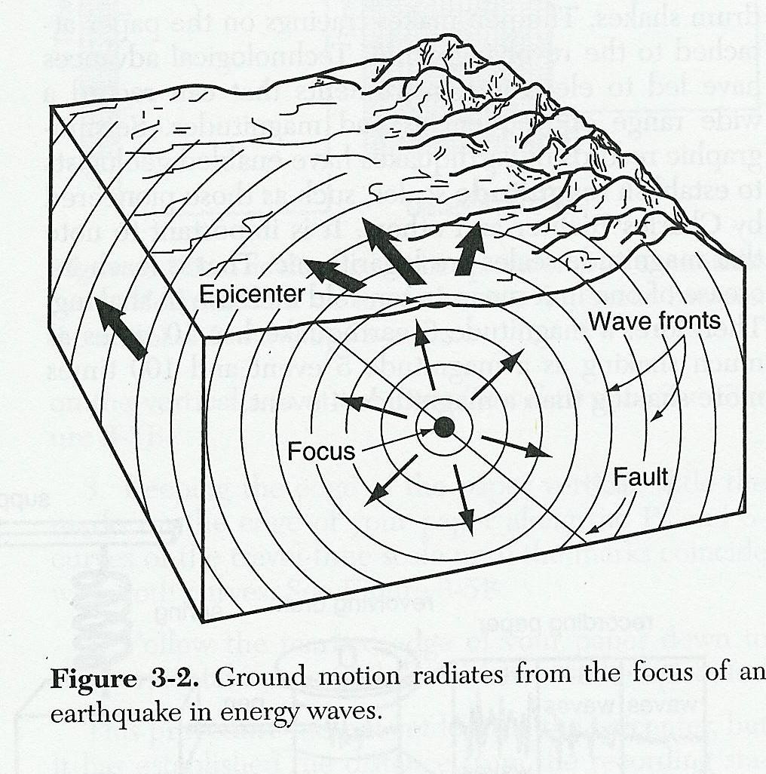

Slide 25
To calculate the distance to an epicenter:
  Calculate the DIFFERENCE in arrival times between the P and S waves.
  S – P
  Place a sheet of paper along the Travel Time axis.
  On this paper, mark a small dot at the time zero and another at the time corresponding to the difference you calculated in step 1. The distance between the two dots represents the difference in arrival times of the P and S waves.
  Keeping the lower dot on the lower graph line, slide the paper to the right until the upper dot touches the upper graph line. KEEP THE PAPER STRAIGHT UP AND DOWN.
  Read straight down to the x-axis and estimate the epicenter distance.
  Calculate distance for each station.
  Set safety compass to distance on scale
  Draw circles around each station to appropriate size.

Slide 26
The location of an earthquake epicenter can only be determined if there is information from three seismic stations. A circle is drawn around each city with seismic information. The earthquake epicenter is where the circles intersect.

Slide 27
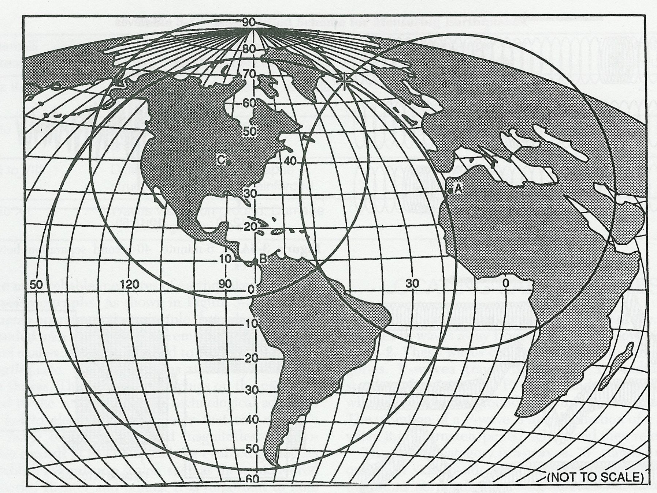

Slide 28
https://www.youtube.com/watch?v=GcqSj43evE0

Slide 29
Earth’s Interior
Seismic waves that shake the Earth provide information to Earth’s internal structure.
Scientists noticed that P-waves travel through the Earth even though they are refracted at boundaries.
However, S-waves do not travel through liquid rock in the mantle and outer core.

Slide 30
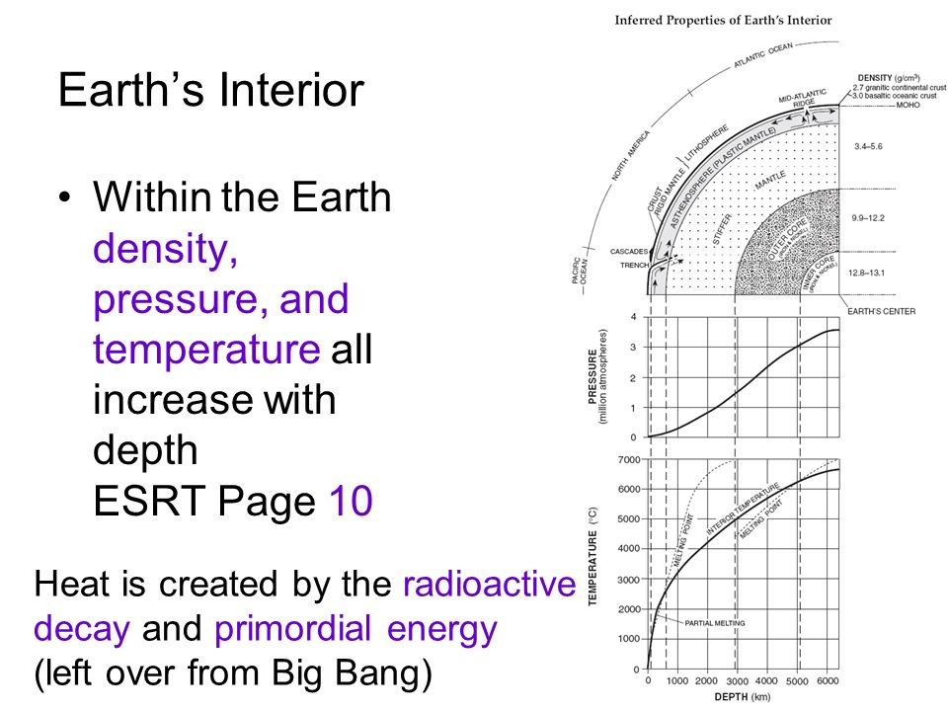

Slide 31
Section 3 – Measuring and Locating Earthquakes
Essential Questions:
  What are earthquakes magnitude and intensity an how are they measured?
  Why are data from at least three seismic stations needed to locate an earthquake’s epicenter.
  Where are the seismic belts?

Slide 32
Earthquake Magnitude and Intensity
More than 1 million earthquakes are felt each year, but news reports on only the largest ones.
Scientists have developed a method of describing earthquakes.
Richter scale is a numeric rating system that measures the energy of the largest seismic waves called magnitude.

Slide 33
The numbers of the Richter scale are determined by the amplitude (height) of the highest wave.
Each number represents an increase of a factor of 10 and the energy released is 32 times greater.
For example, a magnitude 8 it 10 times stronger and releases 32 times more energy than a magnitude 7.

Slide 34
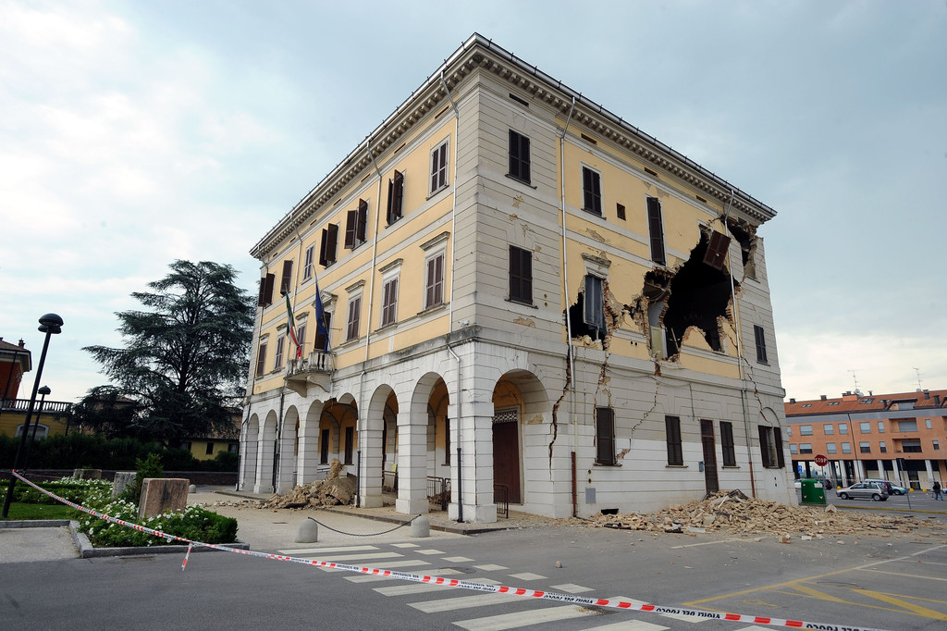
Magnitude 7

Slide 35
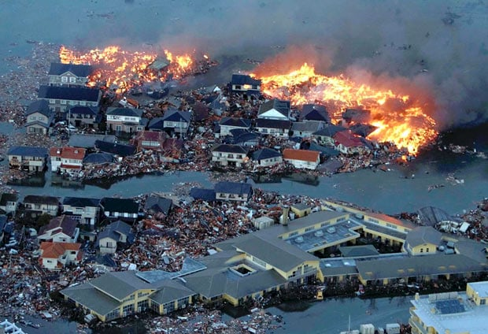
Magnitude 8

Slide 36
Moment Magnitude Scale
Most scientists use the moment magnitude scale.
This is a rating scale that measures the energy released taking into account the size of the rupture, the amount of movement, and the rocks stiffness.
The news often reports the moment magnitude scale.

Slide 37
Modified Mercali Scale
The modified Mercali scale measures the amount of damage caused.
The scale uses the Roman numerals I to XII to designate the intensity.

Slide 38
Deep focus earthquakes produce smaller vibrations than shallow focus earthquakes.

Slide 39
Locating an Earthquake
Just as a person riding a bike will reach a location faster than a person walking, P-waves will reach a seismograph station before the S-wave.
A seismogram will show the P-wave and then the S-wave.
There will be a time difference between the arrival of the two.

Slide 40
The greater the time between the P and S wave the greater the seismogram is from the epicenter.
If you ever watched a detective show on television they may find a person using their cell phone.
They “triangulate” the person using 3 cell towers.

Slide 41
To locate the epicenter of a earthquake scientists need a minimum of 3 seismograms (the more the better).
Since each station will be a different distance from the earthquake, each will have different S and P arrival times.

Slide 42
Time of an Earthquake
The exact arrival times of the P and S-waves are recorded on the seismogram.
For example, a seismogram recorded the arrival of P-waves at exactly at 10:00 am and the P-waves traveled 4500km and took 8 minutes then the earthquake occurred at 9:52am.

Slide 43
Seismic Belts
Earthquakes are not randomly distributed.
A majority occur along a narrow belt.
Like volcanoes, most earthquakes occur along the Circum-Pacific Belt (Ring of Fire).

Slide 44
Section 4 – Earthquakes and Society
Essential Questions:
  What factors affect the amount of damage caused by an earthquake?
  What are some of the factors considered in earthquake-probability studies?
  How are different types of structures affected by earthquakes?

Slide 45
Earthquake Hazards
Earthquakes usually occur along plate boundaries.
However, a magnitude 5 can be catastrophic in one region and harmless in another.
For example, in a rural region of Alaska with no buildings or people will experience little damage. Whereas the same intensity in a large city will be catastrophic.

Slide 46
The height and type of building material will also be a factor.
Taller, weakly build structures are more likely to collapse.
The type of soil can also affect damage.
Soil liquefaction is a process where a nearly saturated soil causes the ground to become liquid like and cause trees and houses to fall over.

Slide 47
https://www.youtube.com/watch?v=RJCidfj-x9M
https://www.youtube.com/watch?v=RJCidfj-x9M

Slide 48
Tsunami
A tsunami is a large ocean wave generated by the vertical motion of the ocean floor.
On 12/26/2004 a magnitude 9.1 earthquake in the ocean caused a 10 meter tall tsunami in the Indian Ocean.
The tsunami killed 225,000 people.
Another giant tsunami hit Japan after an earthquake.

Slide 49
https://www.youtube.com/watch?v=oWzdgBNfhQU

Slide 50
There is no reliable way to forecast an earthquake’s time and location.
Because certain areas are more likely to have an earthquake scientists can say it is likely for an earthquake to occur.

