Slide 1
Plate Tectonics
Section 1: Drifting Continents
Section 2: Seafloor Spreading
Section 3: Plate Boundaries
Section 4: Causes of Plate Motions

Slide 2
Section 1: The shape and geology of the continents suggests that they were once joined together.
Section 2: Oceanic crust forms at ocean ridges and becomes part of the seafloor.
Section 3: Volcanoes, mountains, and deep-sea trenches form at the boundaries between the plates.
Section 4: Convection currents in the mantle cause plate motions.

Slide 3
Section 1 – Drifting Continents
Essential Questions:
What are the lines of evidence that led Wegener to suggest that Earth’s continents moved?
How does evidence of ancient climates support continental drift?
Why was continental drift not accepted when it was first proposed?

Slide 4
Early Observations
In the early 1500’s Dutch cartographer Abraham Ortelius notices the apparent fit of the continents on both sides of the Atlantic Ocean.
During the next 300 years many people commented on the apparent jigsaw match of the continents.

Slide 5
In 1912, German meteorologist Alfred Wegener presented his ideas of continental movement.
Wegener developed a hypothesis that he called continental drift.
He said that the continents were once joined as a supercontinent that he called Pangaea (a Greek word meaning all the Earth.

Slide 6
He said that the Pangaea broke up about 200 million years ago (mya).
Wegener also provided evidence that the continents were once joined by showing similar rock types on both sides of the Atlantic.
He said that layers of rocks in the Appalachian Mountains, Greenland, and Europe were similar.

Slide 7
Wegener also supported his theory by showing evidence of similar fossils.
Wegener reasoned land-dwelling animals could not have swum long distances.
Wegener showed fossils of Cynognathus, Lystrosaurus, and Mesosaurus existed on both sides of the Atlantic.

Slide 8
Wegener showed that there were similar climates on both sides of the Atlantic.
Wegener also showed that there were coal deposits in Antarctica which means that the land was once a warm region swamp close to the equator.
He also found evidence of glaciers in Africa, India, Australia, and South America which meant that these areas were once in polar regions.

Slide 9
Wegener had evidence that the continents were once joined however he could not provide a mechanism as to how these landmasses could move.
Wegener suggested that the rotation of the Earth pushed the continents through the ocean floor.
His theory was NOT accepted.

Slide 10
However, in the 1960’s new technology in seafloor mapping and examination of Earth’s magnetic field revealed that cracks on the Earth’s crust moved these large landmasses.

Slide 11
https://www.youtube.com/watch?v=T1-cES1Ekto
https://www.youtube.com/watch?v=hC1E93lTJbA

Slide 12
Section 2 – Seafloor Spreading
Essential Questions:
What evidence led to the discovery of seafloor spreading?
What is the significance of magnetic patterns on the seafloor?
How is the process of seafloor spreading explained?

Slide 13
Until the 1960’s most scientists thought the ocean floors were flat.
A magnetometer is a device that measures small changes in Earth’s magnetic field.
Magnetometers were dragged behind ships and recorded the magnetism of Earth’s crust.
Sonar was also dragged behind ships to measure sound waves as they bounce off the ocean floor.

Slide 14
Sonar revealed the ocean floor was not flat but had mountain ranges as long as 65,000km and 3 km high.
They also recorded earthquakes and volcanoes on the ocean floor.
The sonar also found deep-sea trenches like the Mariana Trench in the Pacific Ocean that is thousands of kilometers long and 11 km deep (Mt. Everest is 9 km high)

Slide 15
Ocean Rocks and Sediments
Scientists discovered that the ages of rocks on the ocean floor vary.
They found that the rocks near ocean ridges were young and rocks near ocean trenches were older.
This showed that the age of the oceanic crust increased as you move away from ridges.
The pattern is evident on both sides of the ridge.

Slide 16
Scientists also found that sediment on the ocean floors were not as thick as sediments on the continental crust.
This showed that the ocean crust is newer than the continental crust.

Slide 17
Magnestism
Earth’s magnetic field is generated by the flow of molten iron.
The magnetic field causes a compass needle to point North.
Scientists have found that Earth’s magnetic field has changed over time – this is called magnetic reversal.
This would cause compasses to point South.

Slide 18
Earth’s magnetic field has changed several times.
Paleomagnetism is the study of the history of Earth’s magnetic field.
This has shown that Earth’s magnetic field has changed on each side of the Mid-Atlantic Ridge.

Slide 19
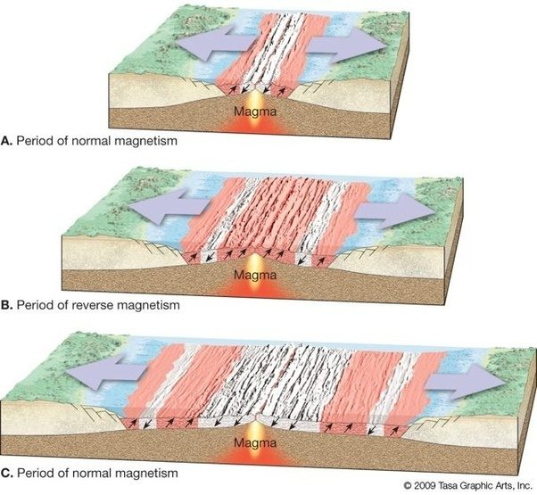

Slide 20
Seafloor Spreading
Seafloor spreading is a theory that explains how new oceanic crust is formed at ocean ridges, moves slowly away from the ridges, and is destroyed at deep-sea trenches.

Slide 21
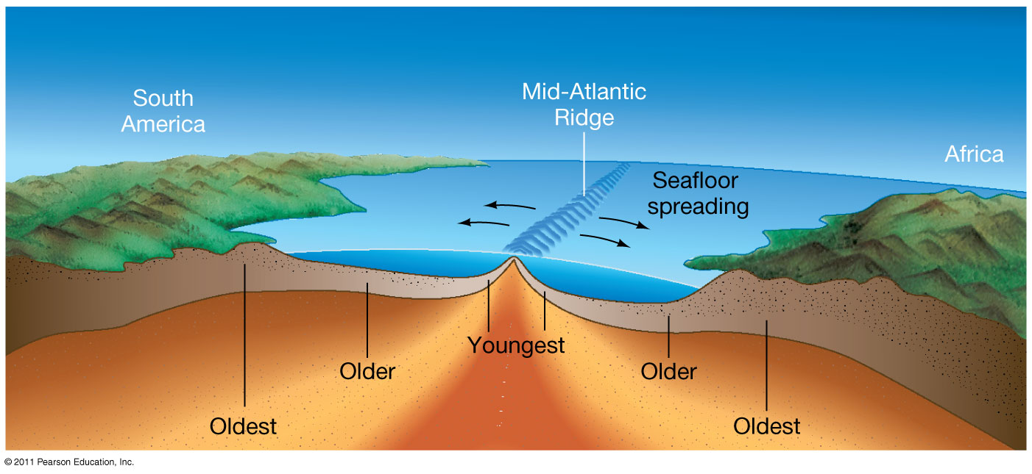

Slide 22
Wegener’s Theory
Wegener could never provide a mechanism for how the continents could move.
Seafloor spreading is the mechanism that proves Wegener’s theory.
The continents move as new crust is formed and old crust is destroyed.

Slide 23
Section 3 – Plate Boundaries
Essential Questions:
How does the movement of Earth’s tectonic plates result in many geologic features?
What are the three types of plate boundaries and the features associated with each?
What are the processes associated with subduction zones?

Slide 24
Theory of Plate Tectonics
Tectonic plates are huge pieces of crust and rigid upper mantle that fit together at their edges to cover Earth’s surface.
There are 8 major plates and several smaller ones.
These plates move very slowly at about a few centimeters per year (about as much as your fingernails grow in a year).

Slide 25
There are different types of boundaries and each has certain geologic features and processes associated with them.
Convergent boundaries move towards each other.
Divergent boundaries move away from each other.
Transform boundaries move horizontally past each other.

Slide 26
Divergent Boundaries
Are usually found along the seafloor.
This is where seafloor spreading occurs.
Magma rises through the seafloor to form a mid-ocean ridge.
The magma causes the seafloor to spread.
When a divergent boundary is found on the continental crust a rift valley is formed.
The rift valley in East Africa will eventually lead to the formation of a new ocean.

Slide 27
Convergent Boundaries
At convergent boundaries two plates move towards each other.
When the plates collide the denser plate moves below the less dense plate in a process called subduction.
There are 3 types of convergent boundaries dependent on the types of crust involved.

Slide 28
Oceanic - Oceanic
One oceanic plate descends below another oceanic plate.
The descending plate is recycled into new crust.
Magma rises up and forms an arc of volcanic islands such as the Mariana Islands and the Aleutian Islands

Slide 29
Oceanic - Continental
The more dense oceanic crust converges with the less dense continental crust.
The subducting oceanic crust produces a trench and a volcanic arc which is a chain of volcanoes.
The Peru-Chile Trench and the Andes mountain range are examples.

Slide 30
Continental - Continental
The edges of two continental crusts collide.
The crusts become crumpled, folded, and uplifted.
This forms large mountain ranges such as the Himalayas

Slide 31
Transform Boundaries
A region where two plates slide horizontally past each other.
Long faults hundreds of kilometers long.
Crust is fractured or transformed along transform boundaries.
Earthquakes are common.

Slide 32
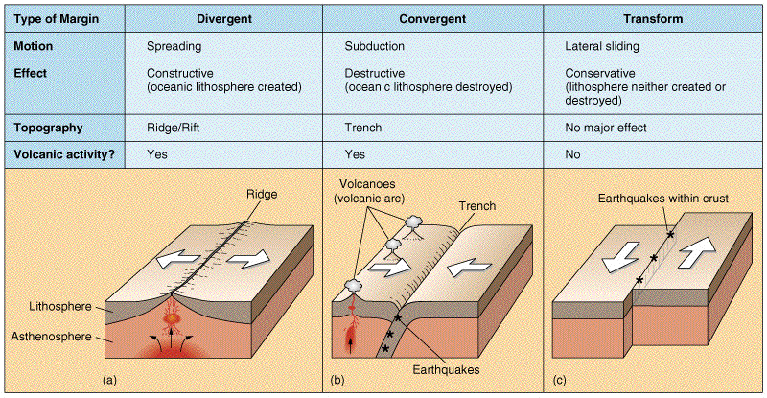

Slide 33
Section 4 – Causes of Plate Motions
Essential Questions:
How is the process of convection explained?
How is convection in the mantle related to the movements of tectonic plates?
What are the processes of ridge push and slab pull?

Slide 34
Convection
Wegener could not develop a mechanism that would cause the continents to move.
Convection is the mechanism that drives the movement of tectonic plates.
The warming of material makes it less dense and rise.
The cooling of material makes it more dense and gravity makes it sink.

Slide 35
This movement of material by heating and cooling is called convection currents.
Convection in the mantle causes the plates to move.
The convection current moves up and spreads divergent boundaries apart.

Slide 36
Ridge push causes the plate to move towards the trench formed at the subduction zone.
Slab pull is the process where the more dense crust pulls the trailing slab into the subduction zone.

Slide 37
