Slide 1
Meteorology
Section 1: The Causes of Weather
Section 2: Weather Systems
Section 3: Gathering Weather Data
Section 4: Weather Analysis and Prediction

Slide 2

Section 1: Air masses have different temperatures and amounts of moisture because of the uneven heating of Earth’s surface.
Section 2: Weather results when air masses with different pressures and temperatures move, change, and collide.
Section 3: Accurate measurements of atmospheric properties are a critical part of weather analysis and prediction.
Section 4: Several methods are used to develop short-term and long-term weather forecasts.

Slide 3
Section 1 – The Causes of Weather
Essential Questions:
  What is the difference between weather and climate?
  How do imbalances in the heating of Earth’s surface create weather?
  How do air mass form?
  What are the five types of air masses?

Slide 4
What is Meteorology?
Meteorology it the study of the physics, chemistry, and dynamics of atmospheric phenomena.
The Greek word meteoros means high in the air.

Slide 5
Weather vs. Climate
Weather is the short-term variations in atmospheric phenomena that interact and affect the environment and life on Earth.
These variations can take place over minutes, hours, days, weeks, months, or years.
Climate it the long-term average of variations of the weather for a particular area.

Slide 6
The sun is always heating a part of Earth’s surface through the day.
The amount of sun that hits Earth’s surface varies by the seasons and that location on Earth’s surface.

Slide 7
Air Masses
An air mass is a large volume of air that has the same characteristics, such as temperature and humidity, as its source region (the area over which an air mass forms).
Maritime tropical air mass (mT) originate over tropical bodies of water.
Continental tropical air mass (cT) originate over the continent.

Slide 8
Maritime polar (mP) form over the cold waters of the North Atlantic and North Pacific.
Continental polar (cP) air masses form over the interior Canada and Alaska.
Artic (A) air masses form above 60°N latitude in Siberia and the Artic basin.

Slide 9
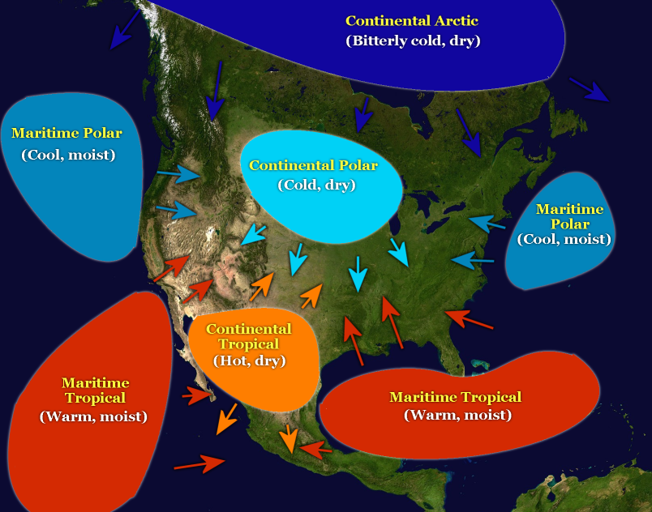

Slide 10
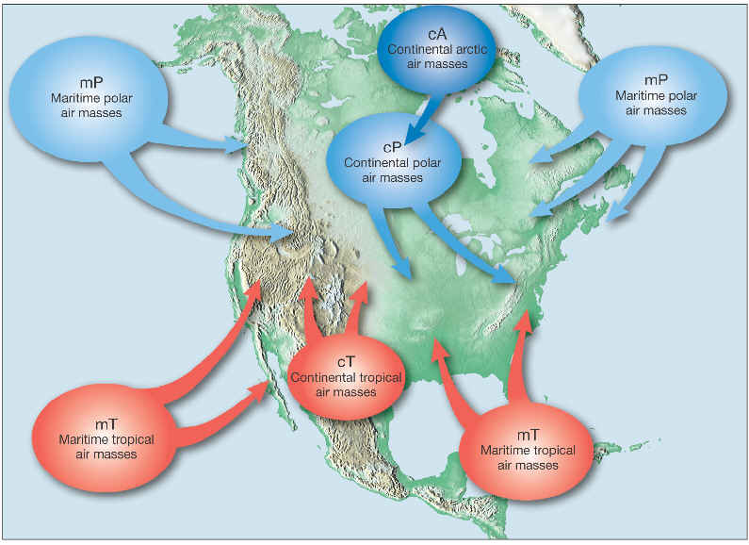

Slide 11
Air masses do not remain in one place indefinitely.
When an air mass undergoes modification, it exchanges thermal energy, moisture, or both with the surface over which it travels.
In the U.S., air masses tend to move from the west to east.

Slide 12
Section 2 – Weather Systems
The direction of Earth’s winds are influenced by Earth’s rotation.
The Coriolis effect results in fluids and object moving in an apparent curved path rather than a straight line.
Moving air curves to the right in the northern hemisphere and to the left in the southern hemisphere.

Slide 13
At the equator the Earth is moving eastward at about 1670 km/h.
If you were at the North Pole and could drop something down towards the equator, the object would land to the right of where you aimed because the Earth rotated to the left below it.

Slide 14
They transport colder air to warmer areas near the equator and warmer air to colder areas near the poles.
Global wind systems equalize thermal energy on Earth.
There are 3 basic wind systems on Earth.

Slide 15
Polar Easterlies
The wind zones between 60°N latitude and the North Pole, and 60°S and the South Pole are called polar easterlies.
Polar easterlies begin as dense polar air sinks and moves towards the east.

Slide 16
Prevailing Westerlies
The wind systems on Earth located between latitudes 30°N and 60°Nand 30°S and 60°S are called prevailing westerlies.
In midlatitudes the winds move in a westerly direction towards the poles.
Prevailing westerlies are steady winds that move much of the weather across the U.S. and Canada.

Slide 17
Trade Winds
Between latitudes 30°N and 30°S are two circulation of wind known as the trade winds.
Air in these regions sinks and moves toward the equator in an easterly direction.
When the air reaches the equator, it warms, rises, and moves back towards latitudes 30°N and 30°S, where the process repeats.

Slide 18
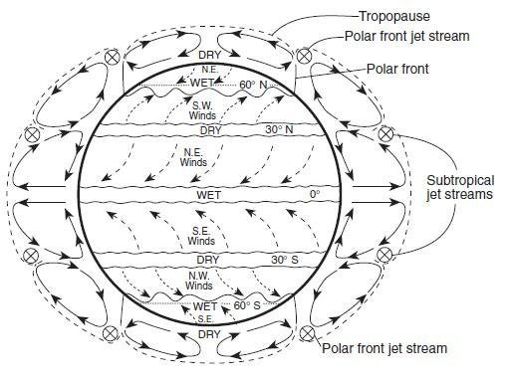

Slide 19
Jet Streams
Wind is the movement of air from an area of high pressure to an area of low pressure.
A large temperature gradient and the Coriolis effect results in strong westerly winds called jet stream.
A Jet stream is a narrow band of fast wind.
The position of the jet stream varies by season.

Slide 20
Weather systems tend to form along the jet stream and generate large-scale weather systems.
The jet stream moves different air temperatures from one region of Earth to another.
Planes flying from LA to NY fly faster because they use the jet stream to fly east.

Slide 21
Fronts
Air masses with different characteristics can collide and result in dramatic weather changes.
A collision of two air masses forms a front.
A front is a narrow region between two air masses of different densities.
The density is from temperature, pressure, and humidity.

Slide 22
Cold front is when cold, dense air displaces warm air.
The warm air is forced up and cools.
Water vapor condenses and thunderstorms are common.
A blue line with evenly spaced blue triangles represents a cold front on a weather map.
Triangles point in the direction of the front’s movement.

Slide 23
A warm front indicates advancing warm air.
A warm front can create light precipitation.
On a weather map, a red line with evenly spaced red semicircles pointing in the direction of the front’s movement.

Slide 24
Stationary front is when two air masses meet but neither one advances.
The two air masses have small temperature and pressure gradients.
Stationary masses have light winds and precipitation.
A stationary mass is indicated by evenly spaced warm and cold front symbols pointed in opposite directions.

Slide 25
Occluded front is when a cold air mass moves so rapidly that it overtakes a warm front and forces the warm air upward.
The advancing cold air mass collides with the cold air mass that was in front of the warm air mass.
Strong winds and heavy precipitation are common.
An occluded front is indicated by alternating purple triangles and semicircles pointing in the direction of the front’s movement.

Slide 26
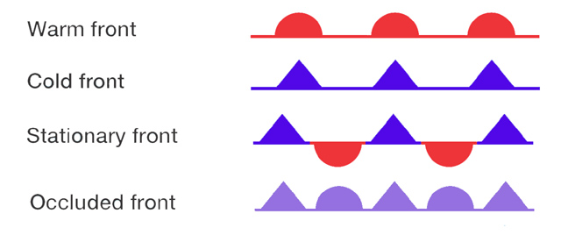

Slide 27
Pressure Systems
Sinking air is associated with high pressure and rising air is associated with low pressure.
Air always flows from an area of high pressure to an area of low pressure.
Air around pressure systems move in a circular motion.

Slide 28
In a low pressure system air rises.
When the air from the outside replaces the air that rises it spirals inward towards the center.
Air in a low pressure system in the northern hemisphere moves in a counterclockwise direction in the northern hemisphere.
As the air rises it cools and condenses to form clouds and precipitation.

Slide 29
A low pressure system is associated with cloudy weather and precipitation.
Low pressure is Lousy weather.

Slide 30
High Pressure
In a high pressure system, sinking air moves away from the system’s center when it reaches Earth’s surface.
The Coriolis effect causes the sinking air to move to the right in a clockwise rotation.
High pressure systems are associated with fair weather.
High pressure is Happy weather.

Slide 31
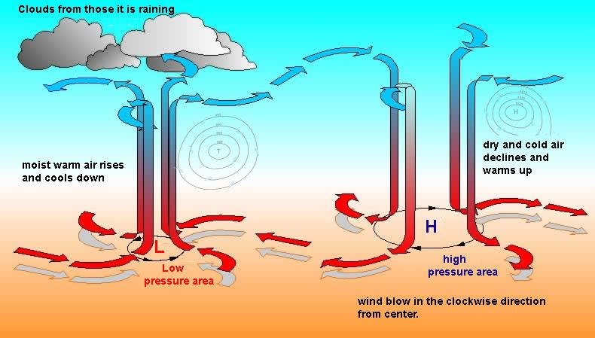

Slide 32
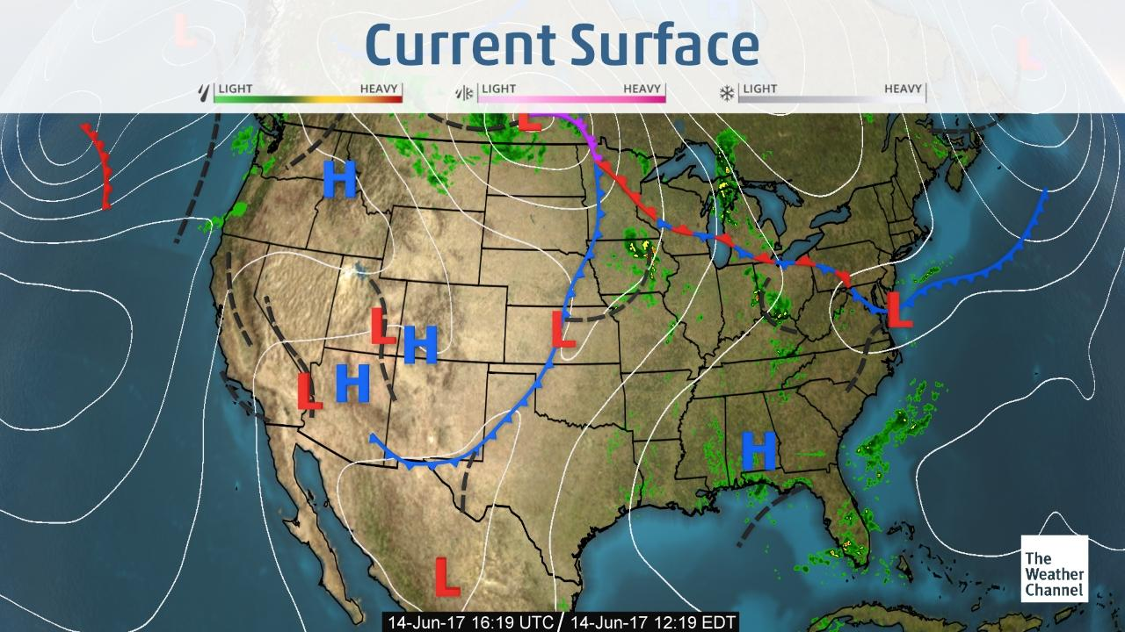

Slide 33
Section 3 – Gathering Weather Data
Essential Questions:
  Why is accurate weather data important?
  What are some of the instruments used to collect weather data from Earth’s surface?
  What are the strengths and weaknesses of weather radar and weather satellites?

Slide 34
Data from Earth’s Surface
Meteorologists measure atmospheric conditions, such as temperature, air pressure, wind speed, and relative humidity.
The quality of the data is critical for precise predictions.

Slide 35
Temperature and Air Pressure
A thermometer measures temperature using either the Fahrenheit or Celsius scale.
Thermometers usually contain alcohol sealed in a glass tube.
The liquid expands when heated or contracts when cooled.
This causes the column to rise or fall.

Slide 36
Barometer
A barometer measures air pressure.
Some barometers have a glass tube filled with mercury.
The tube sits in a container of mercury.
A change of air pressure will cause more of less pressure on the open container causing the mercury in the tube to rise or fall.

Slide 37
Wind Speed and Relative Humidity
An anemometer measures wind speed.
The simplest type has 3 or 4 cupped arms that rotate as the wind blows.
The wind speed is calculated by the number of rotations in a given time.
Anemometers also have a wind vane that shows the direction of the wind

Slide 38
A hygrometer measures humidity.
A hygrometer has a wet-bulb and dry-bulb thermometer.
When water evaporates from the wet-bulb thermometer the bulb cools.
The temperatures are read at the same time and the difference between the two thermometers is calculated.

Slide 39
The relative humidity table lists the specific relative humidity for the difference between the thermometers.

Slide 40
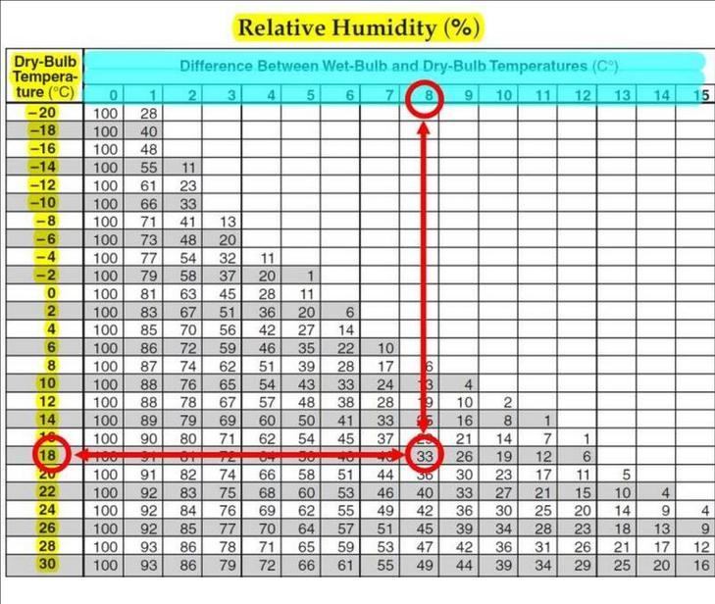

Slide 41
Automated Surface Observing System (ASOS)
There are many monitoring systems around the world that meteorologists use to predict the weather.

Slide 42
Weather Observation Systems
A radiosonde collects data from the upper atmosphere.
Weather radar detects different locations of precipitation.
A radar sends pulses of radio waves out that strike and then bounce off objects.

Slide 43
Doppler weather radar measures the speed of precipitation.
Weather satellites orbit Earth and take images of Earth at regular intervals.
Visible light imagery shows the thickness of clouds.
Water-vapor imagery shows the amount of water vapor in the air.

