Slide 1
Atmosphere
Section 1: Atmospheric Basics
Section 2: Properties of the Atmosphere
Section 3: Clouds and Precipitation

Slide 2
Section 1: Energy is transferred throughout Earth’s atmosphere.
Section 2: Atmospheric properties such as temperature, air pressure, and humidity describe weather conditions.
Section 3: Clouds vary in shape, size, height of formation, and type of precipitation.

Slide 3
Section 1 – Atmospheric Basics
Essential Questions:
What is the gas and particle composition of the atmosphere?
What are the five layers of the atmosphere?
How is energy transferred in the atmosphere?

Slide 4
The air is a combination of gases such as nitrogen and oxygen, and particles, such as dust, water droplets, and ice crystals.
These gases and particles form Earth’s atmosphere.
About 99% of the atmosphere is nitrogen (N₂) and oxygen (O₂).

Slide 5
The remaining 1% consists of argon (Ar), carbon dioxide (CO₂), water vapor (H₂O), and other trace gases.
Water vapor is an invisible gaseous form of water.
The amount of water vapor varies over time and from one place to another.
The concentration varies with the seasons.

Slide 6
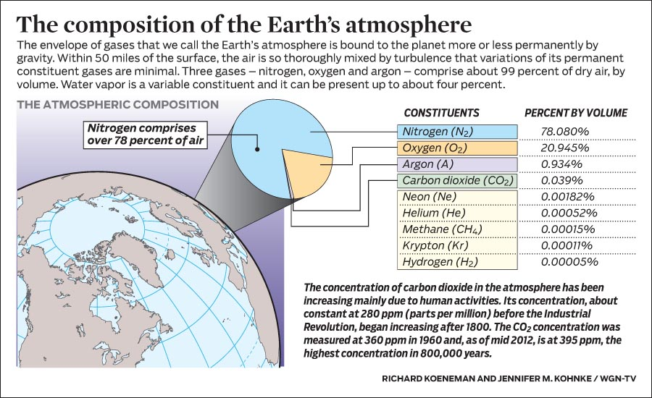

Slide 7
Air over deserts contain less water vapor than air over the oceans.
Carbon dioxide (CO₂) currently makes up about 0.038% of the atmosphere.
During the past 150 years the amount of CO₂ has increased from 0.028%.
The recent increase is due primarily to the burning of fossil fuels.

Slide 8
Ozone (O₃) is found in the ozone layer 20-50km above Earth’s surface.
O₃ has decreased in the past several decades due to chlorofluorocarbons (CFCs) that react with ozone and break it down.
Ozone limits the amount of ultraviolet rays that hit Earth.
Particles of salt, dust, microorganisms, and ice are also found in the atmosphere.

Slide 9
Atmospheric Layers
The atmosphere is classified into five layers.
Each layer differs in composition and temperature.
Troposphere is the layer closest to the Earth.
Weather occurs in the troposphere.
The temperature decreases as altitude increases.

Slide 10
The altitude where the temperature stops decreasing is the tropopause.
The height of the tropopause varies from about 16km in the tropics to about 9km above the poles.
Temperatures at the tropopause can be as low as -60°C.

Slide 11
Stratosphere is above the tropopause.
The temperature increases with altitude.
Contains the ozone layer.
As the altitude increases the temperature increases.
At the stratopause the temperature stops increasing and is about 50km above Earth.
About 99.9% of Earth’s atmosphere is below the stratopause.

Slide 12
Mesosphere is above the stratopause and is about 50-85km above Earth.
Air temperature decreases with altitude.
This occurs because very little solar radiation is absorbed.
The mesopause is above the mesosphere.

Slide 13
Thermosphere is the layer at about 85-600km above Earth.
Because of the low density of air the temperature rises.
The temperature can be up to 2000°C.
The ionsphere which is made up of electrically charged particles, is part of the thermosphere.

Slide 14
Exosphere is the outermost layer of the atmosphere.
It is 600km to 10,000km above Earth’s surface.
In the atmosphere, thermal energy is transferred by radiation, conduction, and convection.

Slide 15
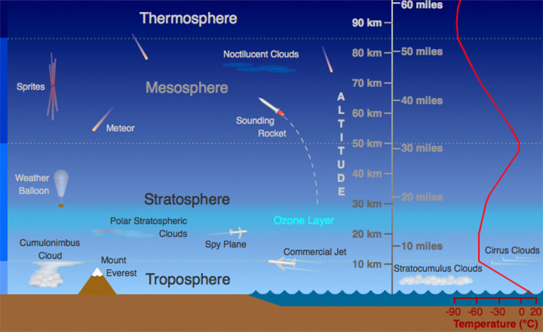

Slide 16
Radiation
Light from the Sun heats up the surface of the Earth.
Radiation is the transfer of thermal energy by electromagnetic radiation.
Waves carry the heat through the atmosphere and is absorbed or reflected by Earth’s surface.

Slide 17
Different objects absorb radiation at different rates.
Darker objects absorb heat faster.
Land heats up and cools down faster than water.
That is why it is cooler at the beach because the water is cooler than the sand on the beach.

Slide 18
Conduction occurs when two objects at different temperatures come into contact.
In solids and liquids the particles transfer the thermal energy from hot particles to cold particles.

Slide 19
Convection is the transfer of thermal energy in the atmosphere and water.
Warm air or water is less dense and will rise above the more dense cold air or water.
When the air or water cools it will become dense again and move down.
This movement is called convection currents.

Slide 20
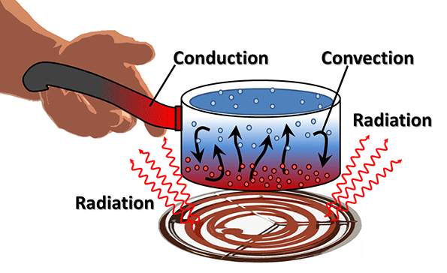

Slide 21
Section 2 – Properties in the Atmosphere
Essential Questions:
What are the three main properties of the atmosphere and how do they interact?
Why do atmospheric properties change with changes in altitude?

Slide 22
Temperature
Temperature is the measure of the average kinetic energy of the particles in motion.
Temperature is measured in Fahrenheit (°F), Celsius (°C), and Kelvin (K).
The Fahrenheit and Celsius scales are based on the freezing and boiling points of water.
The zero point of Kelvin is absolute zero – the lowest temperature that a substance can have.

Slide 24
Air Pressure
Earth’s atmosphere exerts pressure on you due to the weight of the atmosphere on top of you.
Air pressure is the pressure exerted on a surface by the weight of the atmosphere above a surface.
Air pressure is often measured in units of millibars (mb).

Slide 25
At sea level the atmosphere exerts 1000mb.
As you get higher in the atmosphere there is less atmosphere on top of you so there is less pressure.
That is why your ears pop when you go up in a plane.
As you get higher in the atmosphere the density of the air also becomes less.

Slide 26
Pressure-Temperature-Density Relationship
Air with the same density is warmer at a higher pressure than cooler air.
Particles crash into each other more and the temperature goes up.
If the temperature remains the same, the density increases as the pressure increases.
The particles are closer together therefore increasing the density.

Slide 27
Heating air causes the particles to move faster and move apart. This causes the density to decrease.
At the same pressure warm air is less dense than cold air.

Slide 28
Temperature Inversion
In the troposphere temperature decreases with altitude.
However, sometimes in a localized region warmer air is on top of colder air
Rapid cooling of the land can cause a temperature inversion.
A temperature inversion can lead to fog.

Slide 29
Wind
On a summer day when you approach a large building in the city and the door is opened the air conditioned air rushes out.
This is because the warm air is less dense and at a lower pressure so the cold air comes out.
The movement of air is wind.
Wind is the movement of air from an area of high pressure to low pressure.

Slide 30
Wind along Earth’s surface is slowed by friction.
As you get higher the wind gets faster because of less friction.

Slide 31
Humidity
Humidity is the amount of water vapor in the atmosphere at a given location on Earth.
The amount of water vapor in a volume of air relative to the amount of water vapor needed for that volume of air to reach saturation is called relative humidity.
Saturation occurs when the amount of water vapor in a volume of air has reached its maximum amount.

Slide 32
A saturated solution cannot hold anymore of the substance being added.
Dew point is the temperature to which air must be cooled at constant pressure to reach saturation.
Latent heat is the extra thermal energy contained in water vapor compared to liquid water.

Slide 33
Section 3 – Clouds and Precipitation
Essential Questions:
What is the difference between stable and unstable air?
How do low, middle, high, and vertical development clouds differ?
How does precipitation form?

Slide 34
Cloud Formation
A cloud can form when a rising air mass cools.
As less dense, warm air rises it cools and becomes more dense.
The cooling of the air mass causes condensation.
Condensation nucleus is a small particle in the atmosphere around which water droplets can form.

Slide 35
When the number of droplets are large enough a cloud is visible.

Slide 36
Types of Clouds
Cumulus clouds are puffy, lumpy looking clouds below 2000m.
Stratus clouds are layered, sheet-like clouds that can cover much or all of the sky.
Altocumulus and altostratus clouds form at altitudes between 2000m and 6000m.
They are made up of ice crystals and water droplets.

Slide 37
Cirrus clouds are wispy are made up of ice crystals at heights above 6000m.
Cirrostratus and cirrocumulus are also high clouds.

Slide 38
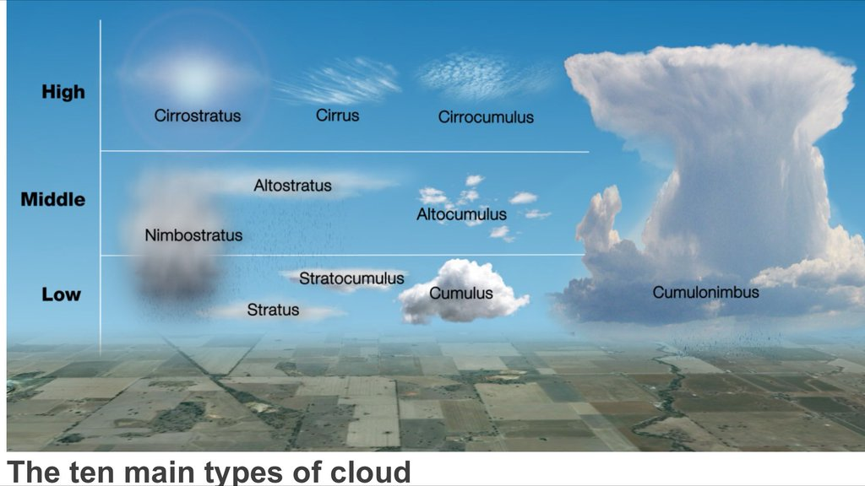

Slide 39
Precipitation
All forms of water that falls from the clouds to the ground are precipitation.
The droplets in the clouds are so small that the upward movement of air keeps them in the cloud.
Coalescence occurs as larger droplets fall and collide with each other and become larger.
When the particles become too large, they fall.

Slide 40
Up and down motion of particles in the clouds will cause hail to form.
The more the hail moves up and down the larger the hail.

Slide 41
The water cycle is the movement of water between the atmosphere and Earth’s surface.
Radiation from the Sun causes liquid water to evaporate.
Water evaporates from lakes, streams, and oceans and rises into the atmosphere.
As the vapor rises, it cools and condenses to form clouds

Slide 42
Water droplets combine to form larger droplets that fall to the ground as precipitation.
This water soaks into the ground or enters lakes, streams, and oceans.
The water eventually evaporates continuing the water cycle.

