Slide 1
Groundwater
Section 1: Movement and Storage of Groundwater
Section 2: Groundwater Weathering and Deposition
Section 3: Groundwater Supply

Slide 2
Section 1: Groundwater reservoirs provide water to streams and wetlands wherever the water table intersects the surface of the ground.
Section 2: Chemical weathering of limestone by water causes the characteristic topography of karst areas.
Section 3: Water is not always available in the quantities and in the locations where it is needed and might be compromised by pollution.

Slide 3
Section 1 – Movement and Storage of Groundwater
Essential Questions:
How do groundwater storage and underground movement relate to the water cycle?
How are aquifers and aquicludes related?
How are the components of aquifers related to the presence of springs?

Slide 4
The Hydrosphere
The water on and in Earth’s crust makes up the hydrosphere.
About 97% of the hydrosphere is in the ocean.
Freshwater is one of the Earth’s most abundant and important renewable resources.

Slide 5
Groundwater and Precipitation
The ultimate source of all water is the oceans.
Evaporation from the oceans cycles into the atmosphere.
Winds and weather moves the moisture all over the world.
Infiltration is the process by which precipitation that has fallen on land and trickles into the ground.

Slide 6
Groundwater moves slowly through the ground.
Water seeps into the ground through pore spaces.
The greater the porosity the more water can be stored.

Slide 7
Zone of saturation is the area below the Earth’s surface in which the groundwater completely fills all the pores of a material.
The upper boundary is the water table.
The zone of aeration is above the water table where materials are moist but not wet.

Slide 8
Water Movement
Water can move through the ground by gravity or capillary action.
Gravitational water is water that trickles down due to gravity.
Capillary water is water that is drawn upward like a paper towel absorbing water.

Slide 9
The depth of the water table will vary depending on local conditions.
In wet areas the water table will be close to the surface.
In hilly areas the water table will be tens or hundreds of meters down.
The water table will fluctuate based on the weather conditions.

Slide 10
Groundwater flows downhill.
The water flows slowly based on the permeability of the ground.
Sand and gravel will allow the water to pass easily.
Aquifers are underground water storage areas that allow the water to pass through.
Aquicludes prevent the flowing or water.

Slide 11
Springs occur where the water table intersects with Earth’s surface.
Groundwater will emerge and flow from the ground.
The amount of water may be a trickle or it might be enough to form a stream.

Slide 12
Hot springs have a temperature that is above 36.6°C.
A human’s average body temperature is 37°C.
There are thousands of hot springs in the U.S. due to igneous activity.
Geysers are explosive hot springs.
Old Faithful is a geyser located in Yellowstone National Park in Wyoming and erupts every 35-120 minutes and can reach heights of 27-55m.

Slide 13
Old Faithful Erupting
https://www.youtube.com/watch?v=wE8NDuzt8eg

Slide 14
Section 2 – Groundwater Weathering and Deposition
Essential Questions:
How does groundwater dissolve and deposit rocks and minerals?
How do caves form?
What features are characteristic of karst topography?

Slide 15
Carbonic acid forms when carbon dioxide gas dissolves in water and combines with water molecules.
Carbonic acid causes groundwater to be slightly acidic.
The slightly acidic water attacks limestone to break it down over time.

Slide 16
Carbon dioxide and water combine to form carbonic acid.
Carbonic acid splits into hydrogen ions and bicarbonate atoms.
Hydrogen ions react with calcite to form calcium ions and bicarbonate ions.

Slide 17
The reaction is as follows:
CO₂ + H₂O → H₂CO₃
H₂CO₃ → H⁺ + HCO₃ˉ
CaCO₃ + H⁺ → Ca²⁺ + HCO₃ˉ

Slide 18
Caves are natural underground openings.
Most caves are formed when the groundwater dissolves limestone.
Karst topography is a landscape characterized by a landscape of sinkholes formed from the dissolution of limestone.
A sinkhole is a depression in the ground caused by the collapse of a cave.

Slide 19
Karst topography is common in Kentucky, Indiana, Florida, and Missouri.
The Mammoth Cave in Kentucky contains tens of thousands of sinkholes.

Slide 20
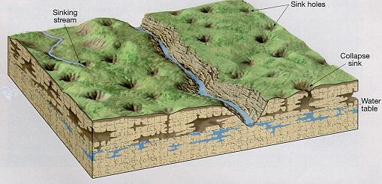

Slide 21
Groundwater Deposits
Calcium ions precipitate from groundwater and form new calcite minerals.
These minerals create dripstone.
These features are created over time from the drip of calcite rich water.
Stalactites are dripstones that hang from the ceiling of caves.
Stalagmites are dripstones that form on the ground from drips from stalactites.

Slide 22
Over time stalactites and stalagmites will meet and form dripstone columns.
Hardwater is water that contains dissolved solids such as calcium, magnesium, and iron.

Slide 23
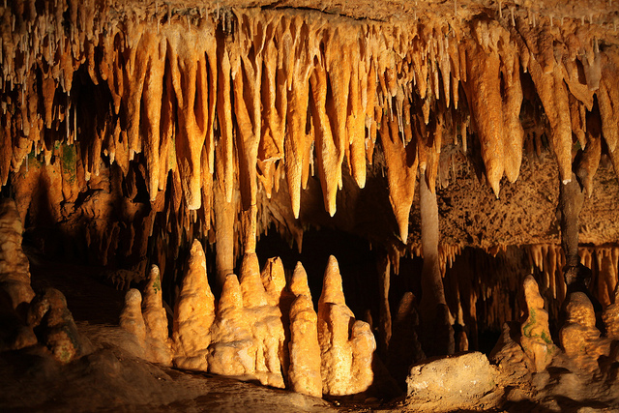

Slide 24
Section 3 – Groundwater Supply
Essential Questions:
How is groundwater withdrawn from aquifers?
What are the major problems that threaten groundwater supplies?

Slide 25
Well are holes dug down into the ground to reach an aquifer.
Ordinary wells are dug down to the water table.
As water is drawn out it is replaced by surrounding water.
If too much water is withdrawn it will cause shallow wells to become dry.

Slide 26
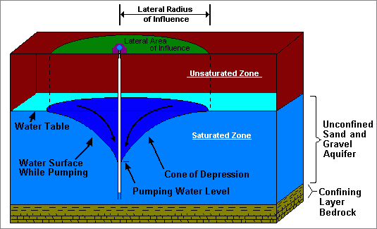

Slide 27
Water from precipitation will replace water that is taken out.
This is called recharge.
Artesian wells can spurt water above the land surface.
A spring that discharges pressurized water is called an artesian spring.

Slide 28
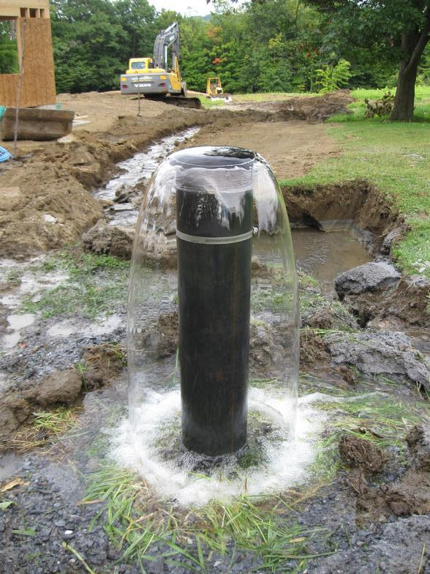
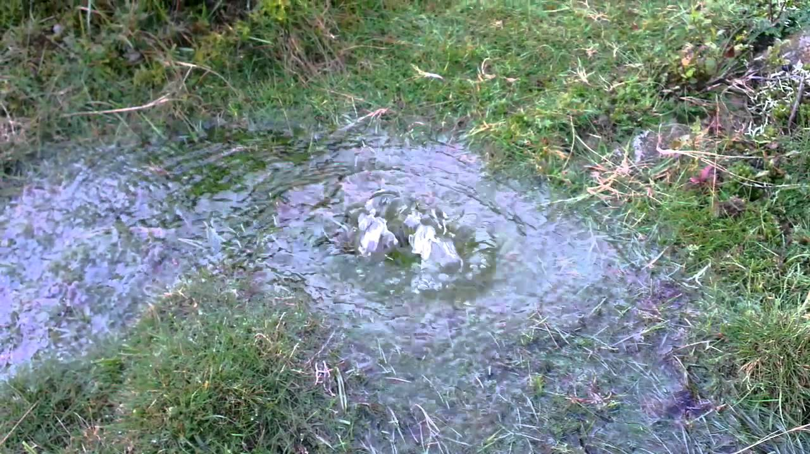
Artesian Well and Spring

Slide 29
Threats To Our Water Supply
Freshwater is a precious natural resource.
Human demand for freshwater is enormous.
An important aquifer in the U.S. is the Ogallala Aquifer that covers areas from South Dakota to Texas.
Water from this aquifer is used to water crops grown in these areas.
The water is not being recharged as quickly as it is withdrawn.

Slide 30
Overuse – groundwater is pumped out at a greater rate than recharged.
Subsidence – excessive withdrawal of water causes the sinking of land.
Pollution in groundwater – when the recharge areas of an aquifer are contaminated, the groundwater is contaminated.

Slide 31
Sources of groundwater pollution includes faulty septic tanks, farms, landfills, and waste disposal sites.
Chemicals can travel through the smallest pores.
Chemicals can contaminate any aquifer.
In coastal areas salt from ocean water can contaminate wells.

Slide 32
Radon is a gas that is known to cause lung cancer.
It is found in groundwater due to natural radioactive decay within rocks.
Radon gas can also accumulate in basements.

Slide 33
Protecting our groundwater should be a concern for us.
We should be aware of what we put onto the ground because it can make its way into our water.

