Slide 1
Chapter 1 - The Nature of Science
Section 1: Earth Science
Section 2: Methods of Scientists
Section 3: Communication in Science

Slide 2
Section 1 - Essential Question
How do the areas of study within Earth science compare?

Slide 3
Section 1 – Earth Science
The scope of Earth Science is broad and can be broken down into five major areas of specialization:
Astronomy
Meteorology
Geology
Oceanography
Environmental Science

Slide 4
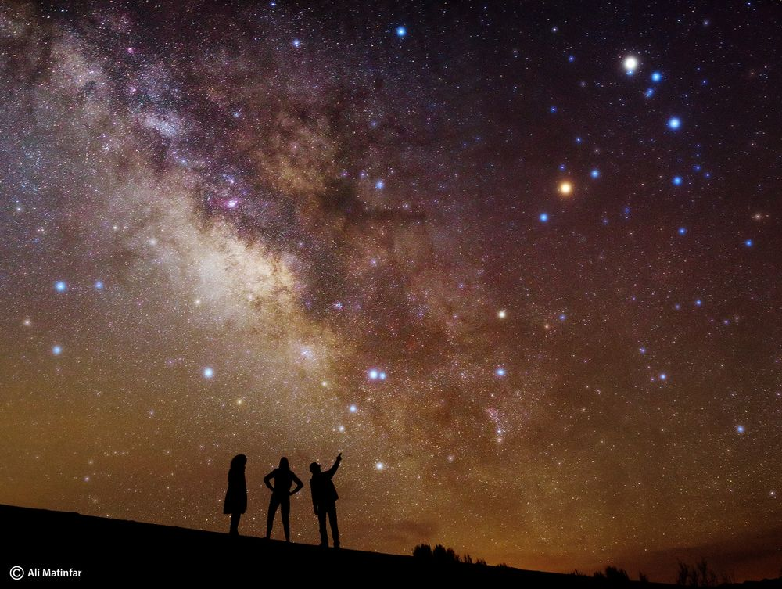
Astronomy
The study of objects beyond Earth’s atmosphere.

Slide 5
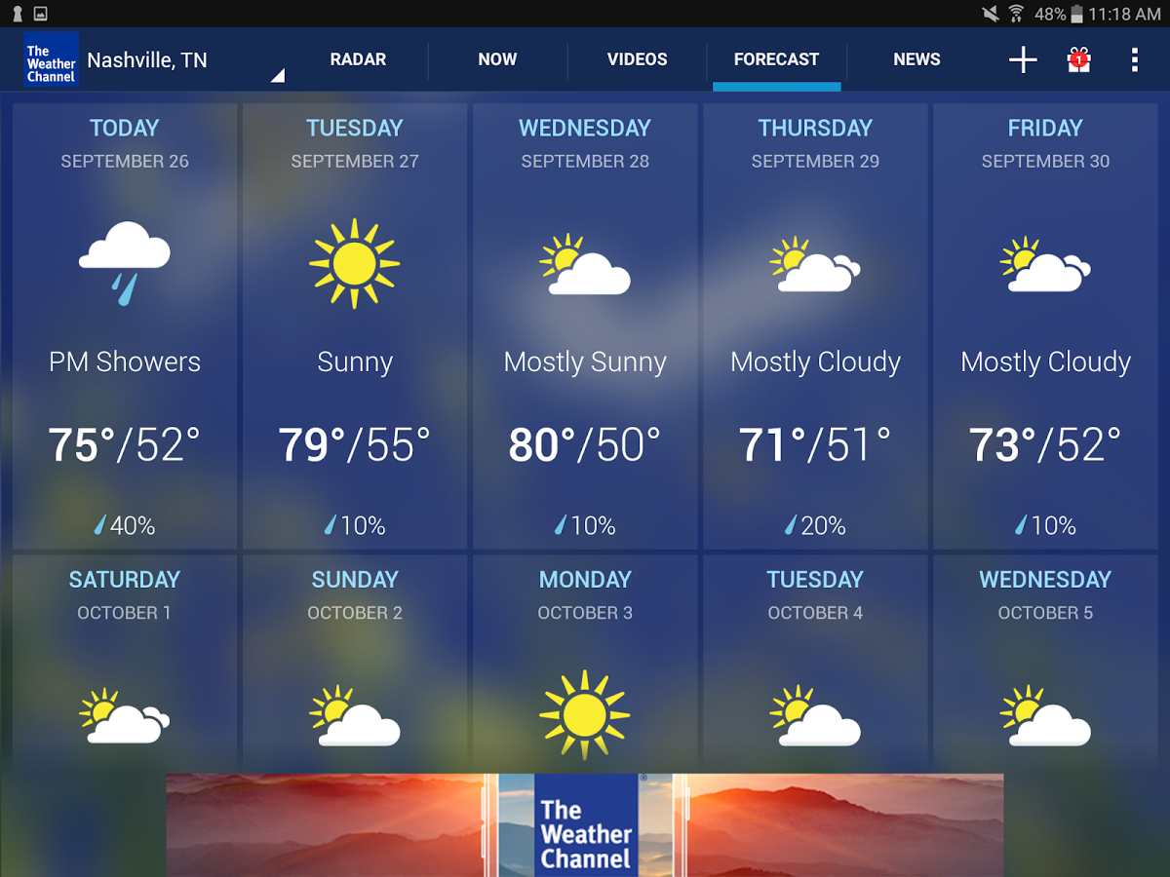
Meteorology
The study of forces and processes that cause the atmosphere to change and produce weather.

Slide 6
Geology
The study of the materials that makeup Earth, the processes that form and change these materials, and the history of the planet and its life-forms since its origin.

Slide 7
Oceanography
The study of Earth’s oceans which cover nearly three-fourths of the planet.

Slide 8
Environmental Science
The study of the interactions of the organisms and their surroundings.

Slide 9
Essential Question
What are Earth’s systems?
What are the relationships among Earth’s systems?

Slide 10
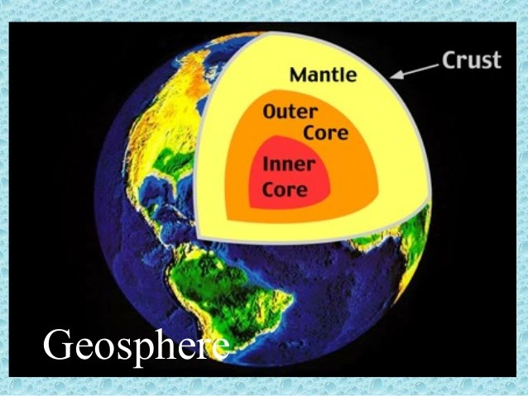
Earth’s Systems
Scientists who study Earth have identified 4 main Earth systems:
Geosphere – the area from the surface of the Earth down to its center.

Slide 11
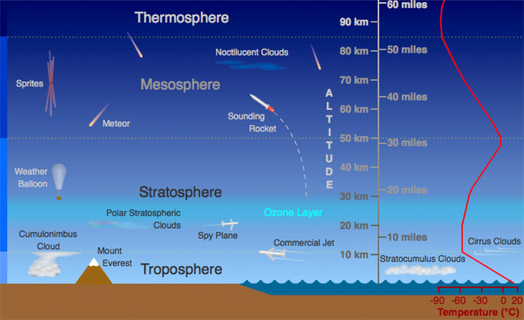
Atmosphere – the blanket of gases that surrounds our planet.

Slide 12
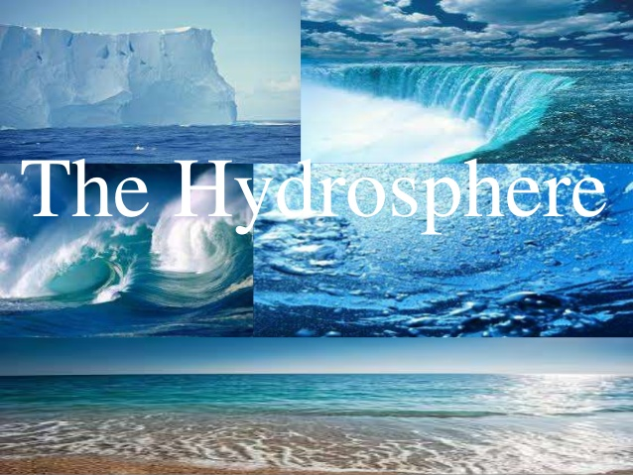
Hydrosphere – all the water on Earth, including the atmosphere.
97% salt water
3% fresh water in glaciers (cryosphere), lakes, rivers, and under the ground

Slide 13
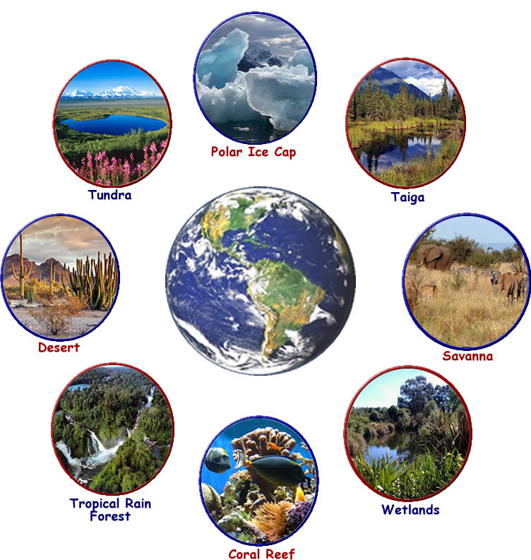
Biosphere – includes all organisms on Earth as well as the environments in which they live. (covered in Living Environment).

Slide 14
Essential Question
Why is technology important?

Slide 15
Technology
The study of science, including Earth Science, has led to many discoveries that have been applied to solve society’s needs and problems.

Slide 16
Section 2 – Methods of Scientists
All scientists use similar methods to gather data and communicate information.
Scientific methods are a series of problem solving procedures that held scientists conduct experiments.
Once a scientist determines the problem, a hypothesis is made.
Hypothesis – is a testable explanation of a situation that can be supported or disproved by careful procedures.

Slide 17
Section 2 - Essential Questions
What are independent and dependent variables?
How does experimentation and investigation differ?
What are the differences between mass and weight?
What is scientific notation and how is it used?

Slide 18
Independent and Dependent Variables
Experimentation – collecting good qualitative and quantitative data.
Independent variable – is the factor that is changed by the experimenter.
Dependent variable – is a factor that is affected by changes in the independent variable.
Control – is used in an experiment to show that the results of an experiment are a result of he condition being tested.

Slide 19
Measurement
Scientific investigations often involve making measurements.
The measurement includes a standard system of units called Le Système International d’Unitès (SI), which is the modern version of the metric system.

Slide 20
Length
The SI unit to measure length is the meter (m).

Slide 21
Mass
The amount of matter in an object is called mass.
Mass depends on the number and types of atoms that make up an object.
The mass of an object NEVER changes, only the weight changes.
The SI unit of mass is kilogram.

Slide 23
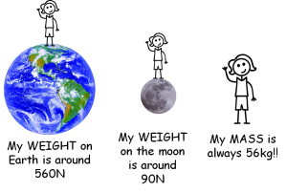
Weight
Weight is the measure of the gravitational force of an object.
The SI unit of forces is the newton (N).

Slide 24
Area and Volume
Area is the amount of surface included in a set of boundaries and is expressed as square meters (m²).
Volume is the amount of space occupied by an objects volume. It can be used to measure solids, liquids, and gases.
It is expressed as a cubic meter (m³) or cubic centimeter (cm³)

Slide 25
Area

Slide 26
Volume of Regular Object

Slide 27
Volume of Irregular Object

Slide 28
Density
Density – the measure of the amount of matter that occupies a given space.
Density is calculated by dividing the mass of the matter by it volume.
D=m/v
Density is often expressed as grams per cubic centimeter (g/cm³)

Slide 29
Gas vs Liquid vs Solid

Slide 30
Time
Time is the interval between two events.
It is measured in units of seconds, minutes, hours, days, months, years, decades, centuries, etc.

Slide 31
Temperature
Temperature is the measure of the average kinetic energy of the particles that make up a material.
If the particles vibrate more quickly it has a higher temperature.

Slide 33
Scientific Notation
Scientific Notation is used to express very large or very small numbers in a type of shorthand.
The estimated number of grains of sand on Earth is 4,000,000,000,000,000,000,000 or 4x10²¹
The estimated mass of the Earth is 5,973,600,000,000,000,000,000,000 kg or 5.9736x10²⁴kg

Slide 34
The diameter of an atom is approximately 0.0000000001m or 1x10ˉ¹⁰m.

Slide 35
Section 3 – Communication in Science
Essential Questions
Why is precise communication crucial in science?
What are the differences between scientific theories and laws?
When is it appropriate to use a graph or a model?

Slide 36
Communicating Results
Lab Reports are used to record and analyze the information you collected and to draw conclusions based on your data.
Line graphs, circle graphs, and bar graphs show the relationships among data sets.
Scientific model is an idea picture, a system, or mathematical expression that represents the concept being explained.

Slide 37
Theories and Laws
Scientific Theory is an explanation based on many observations during repeated investigations.
Scientific Law is a principle that describes the behavior of natural phenomenon. It is a rule of nature. The events of a law every time.

Slide 38
Vocabulary
Review
technology
experiment
hypothesis
New
astronomy
meteorology
geology
oceanography
environmental science
geosphere
atmosphere
hydrosphere
cryosphere
biosphere
New continued
scientific methods
hypothesis
independent variable
dependent variable
control
Le Système International d’Unités (SI)
scientific notation
scientific model
scientific theory
scientific law
The Nature of Science
Copyright © McGraw-Hill Education

